Slide 1
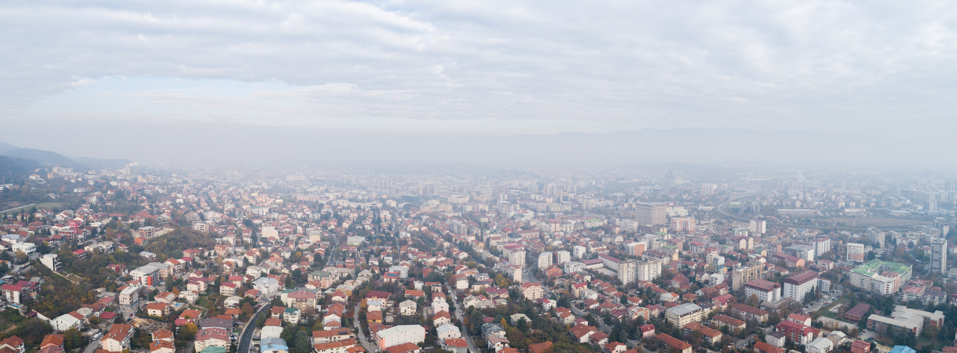
Do we understand the problem with ambient air pollution – Skopje case
Dejan Mirakovski

Slide 2
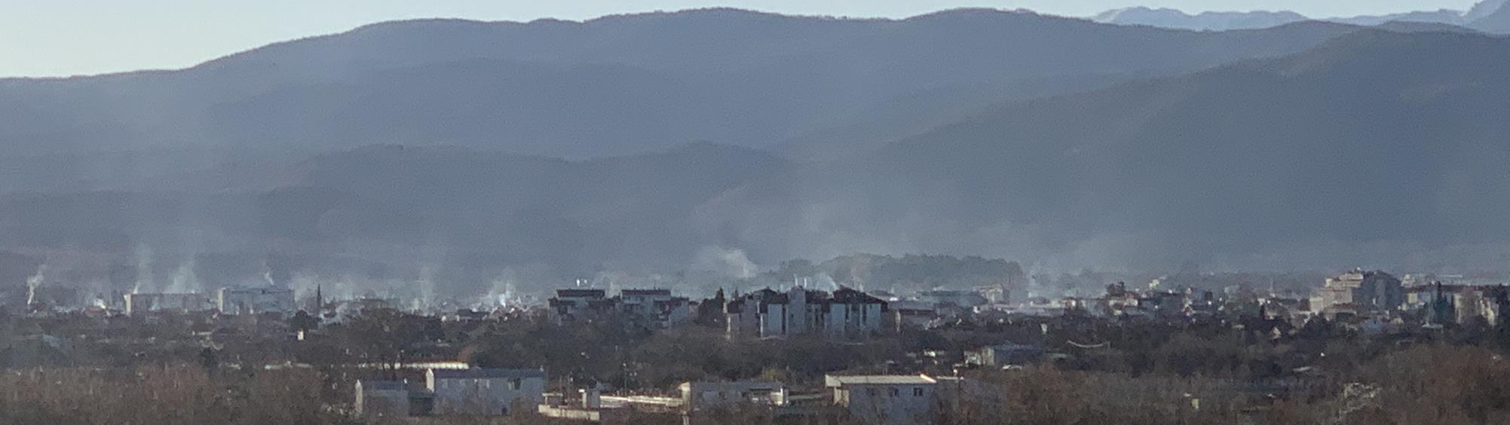
Western Balkans ambient air pollution
EU regional average
According to the 2020 evaluation by the European Environment Agency, the Western Balkan region is identified as one of the most polluted areas in Europe, with Skopje ranking as one of the most polluted capitals on the continent [Madjar et al.,2023].
Top 5 EU economies (Germany, France, Italy, Spain and Netherlands)

Slide 3
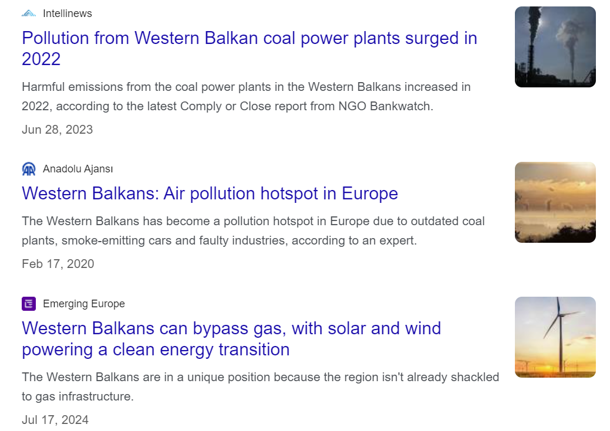
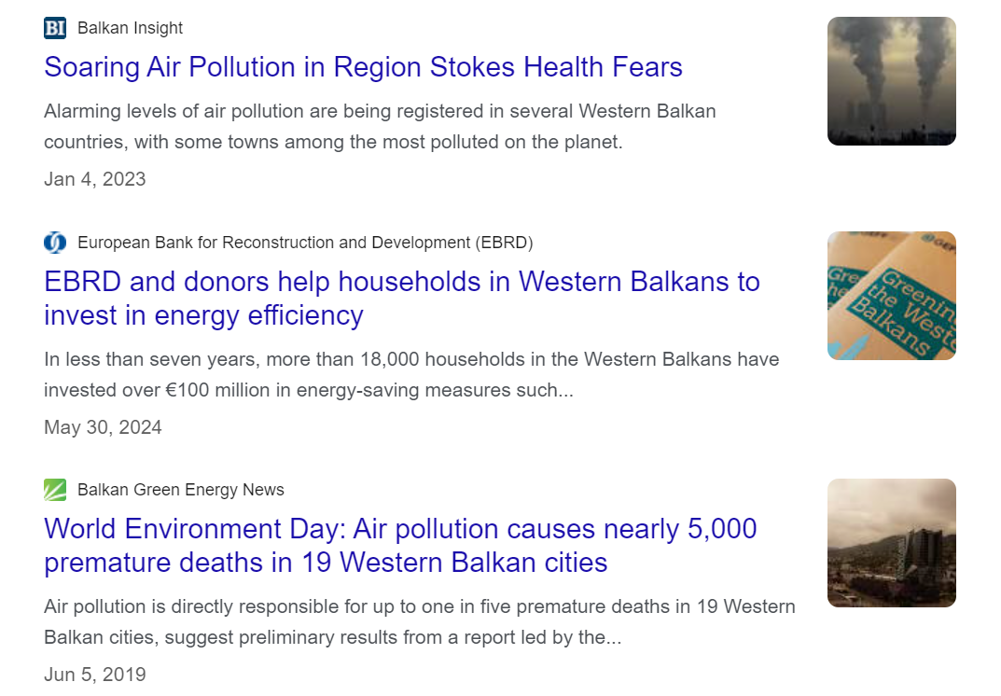
And we speak “loudly” about this problem…

Slide 4
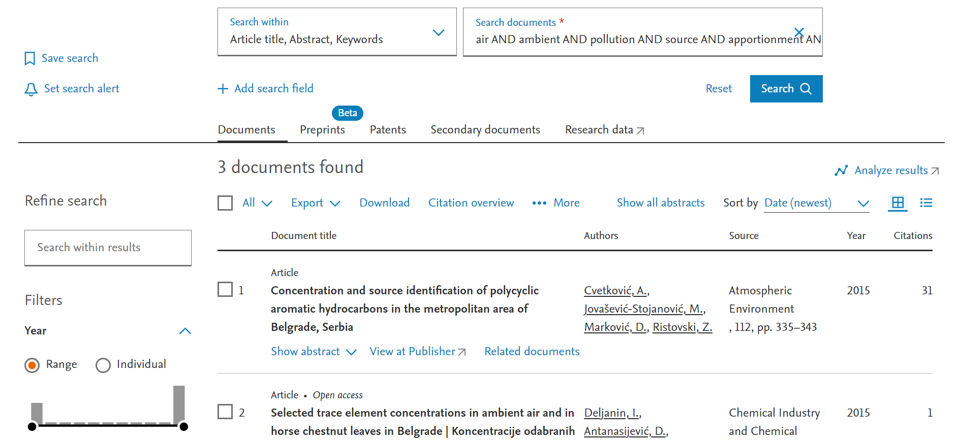
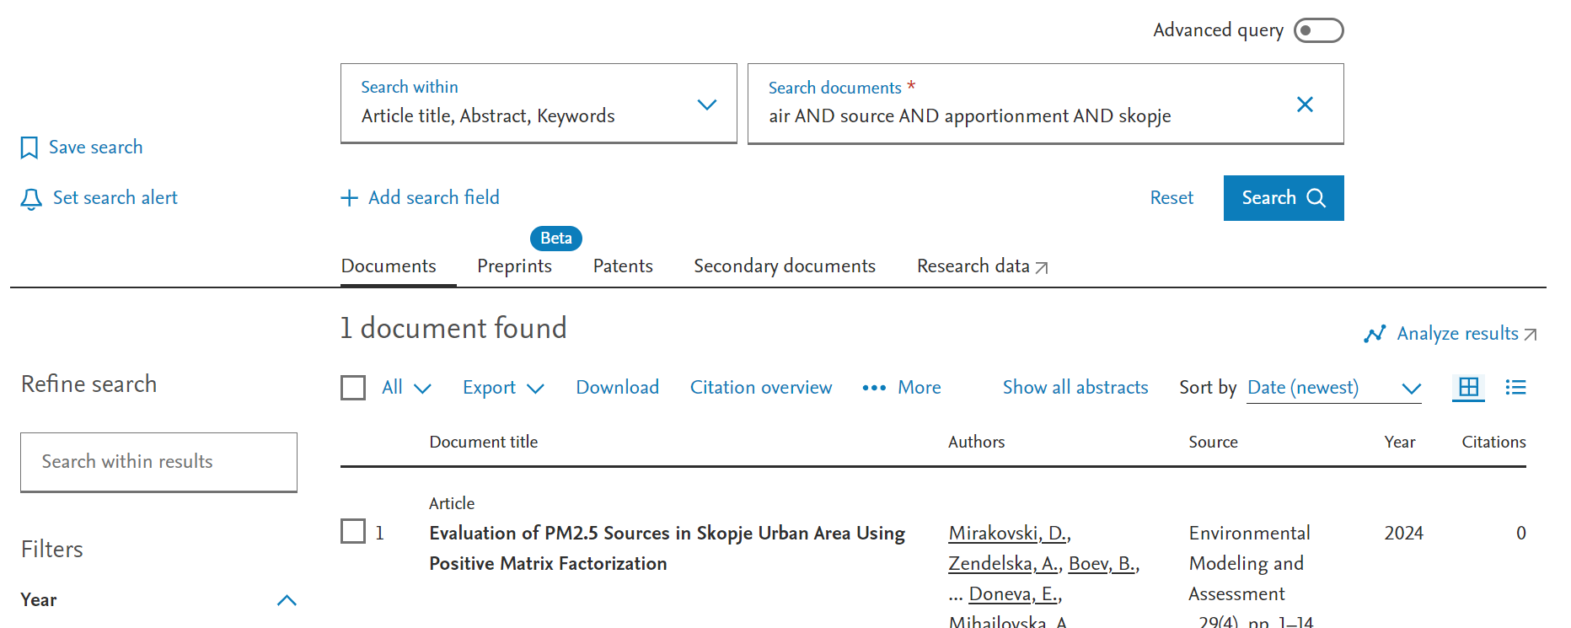
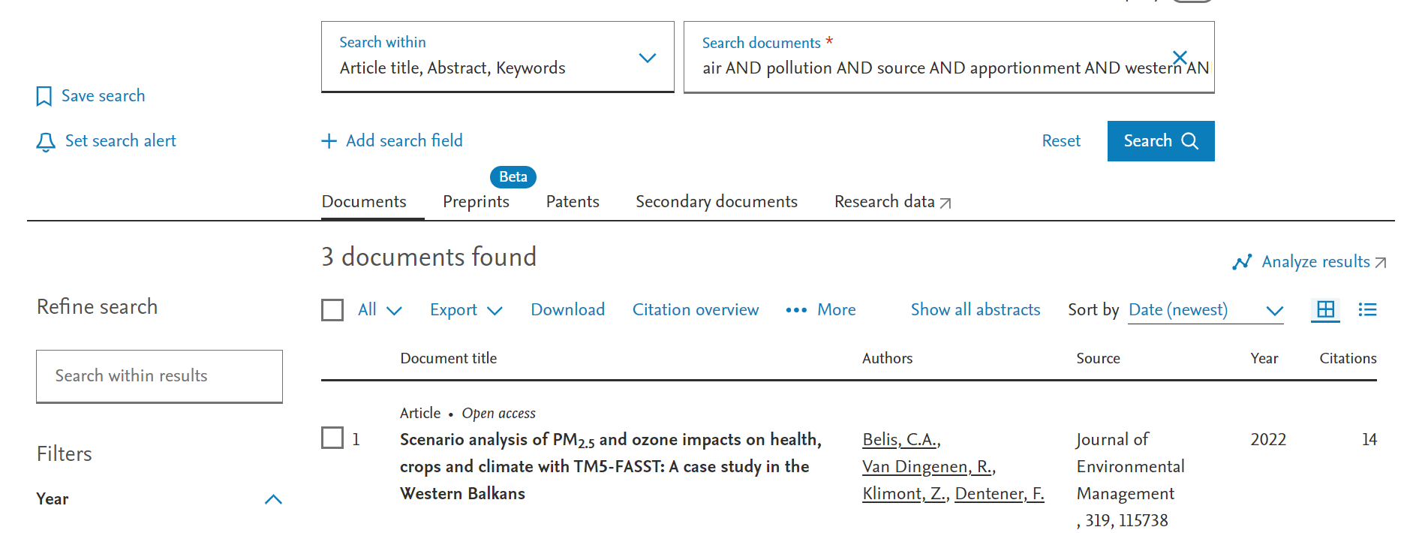
But do we use science to solve it?
Utilizing the Scopus database with different keyword combinations, including ambient air, pollution, and source apportionment, alongside specific countries or geographic regions (Western Balkans, Serbia, North Macedonia, Montenegro, Albania, and Bosnia), resulted in a limited number of published studies, comprising only a few documents for Serbia, one for North Macedonia, and none for Albania, Montenegro, and Bosnia.
Searching the Scopus database with different keyword combinations, including ambient air, pollution, and source apportionment, alongside specific countries or geographic regions (Western Balkans, Serbia, North Macedonia, Montenegro, Albania, and Bosnia), resulted in a limited number of published studies, comprising only a few documents for Serbia, one for North Macedonia, and none for Albania, Montenegro, and Bosnia.

Slide 5
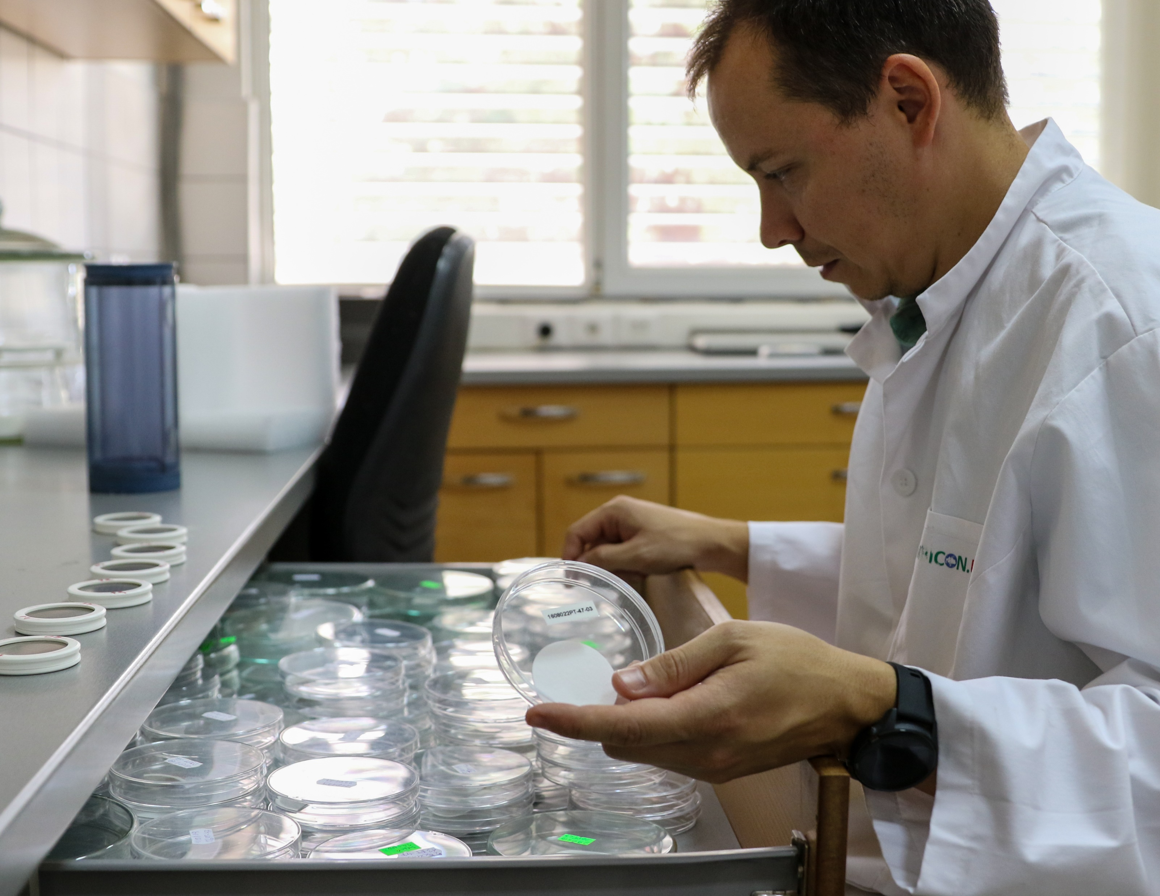
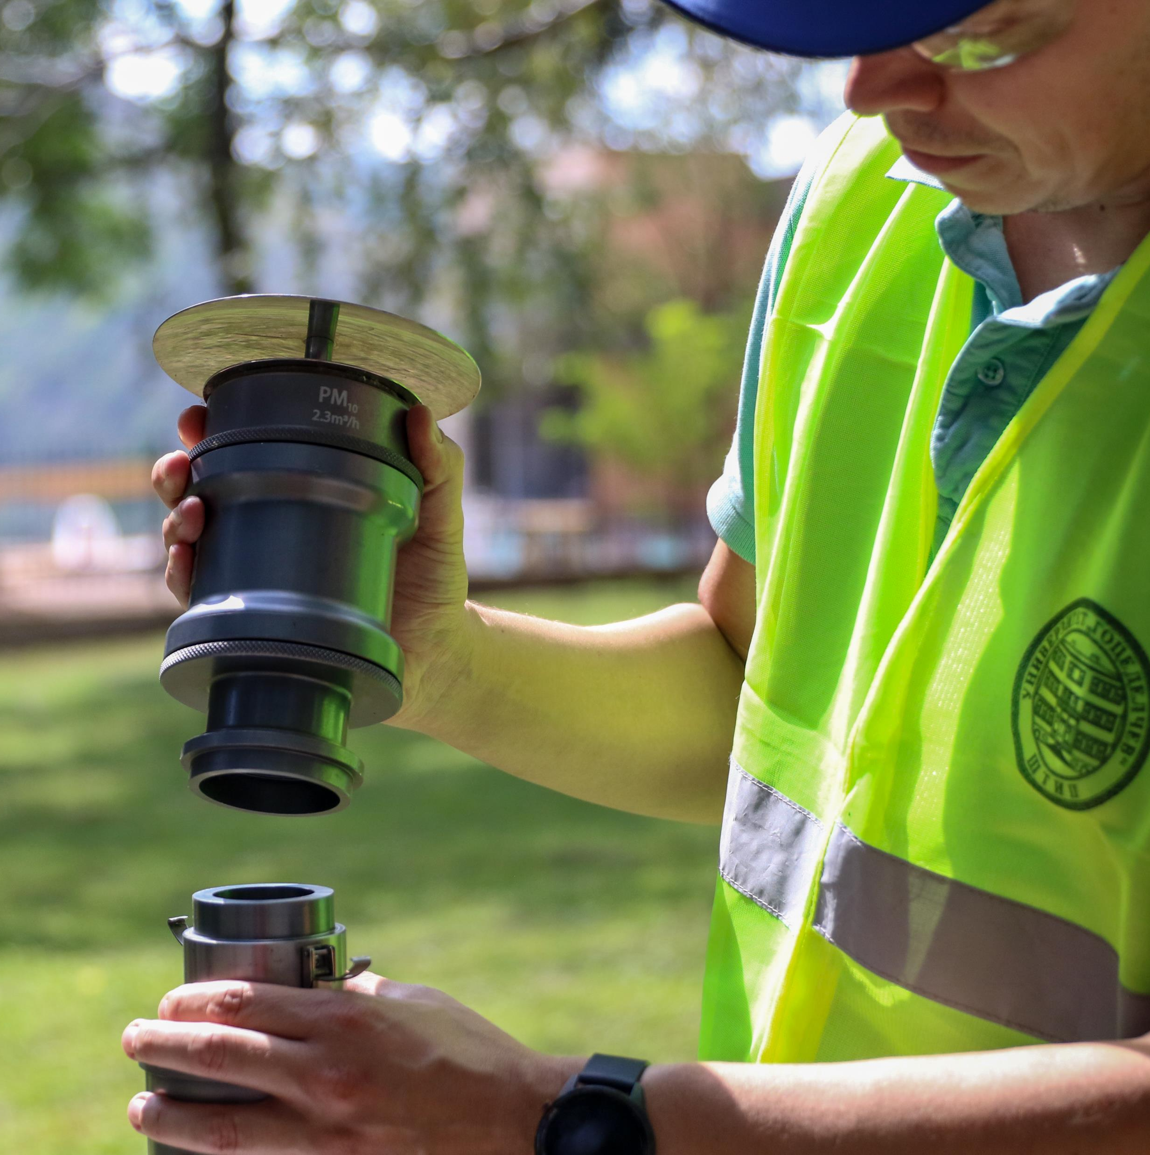
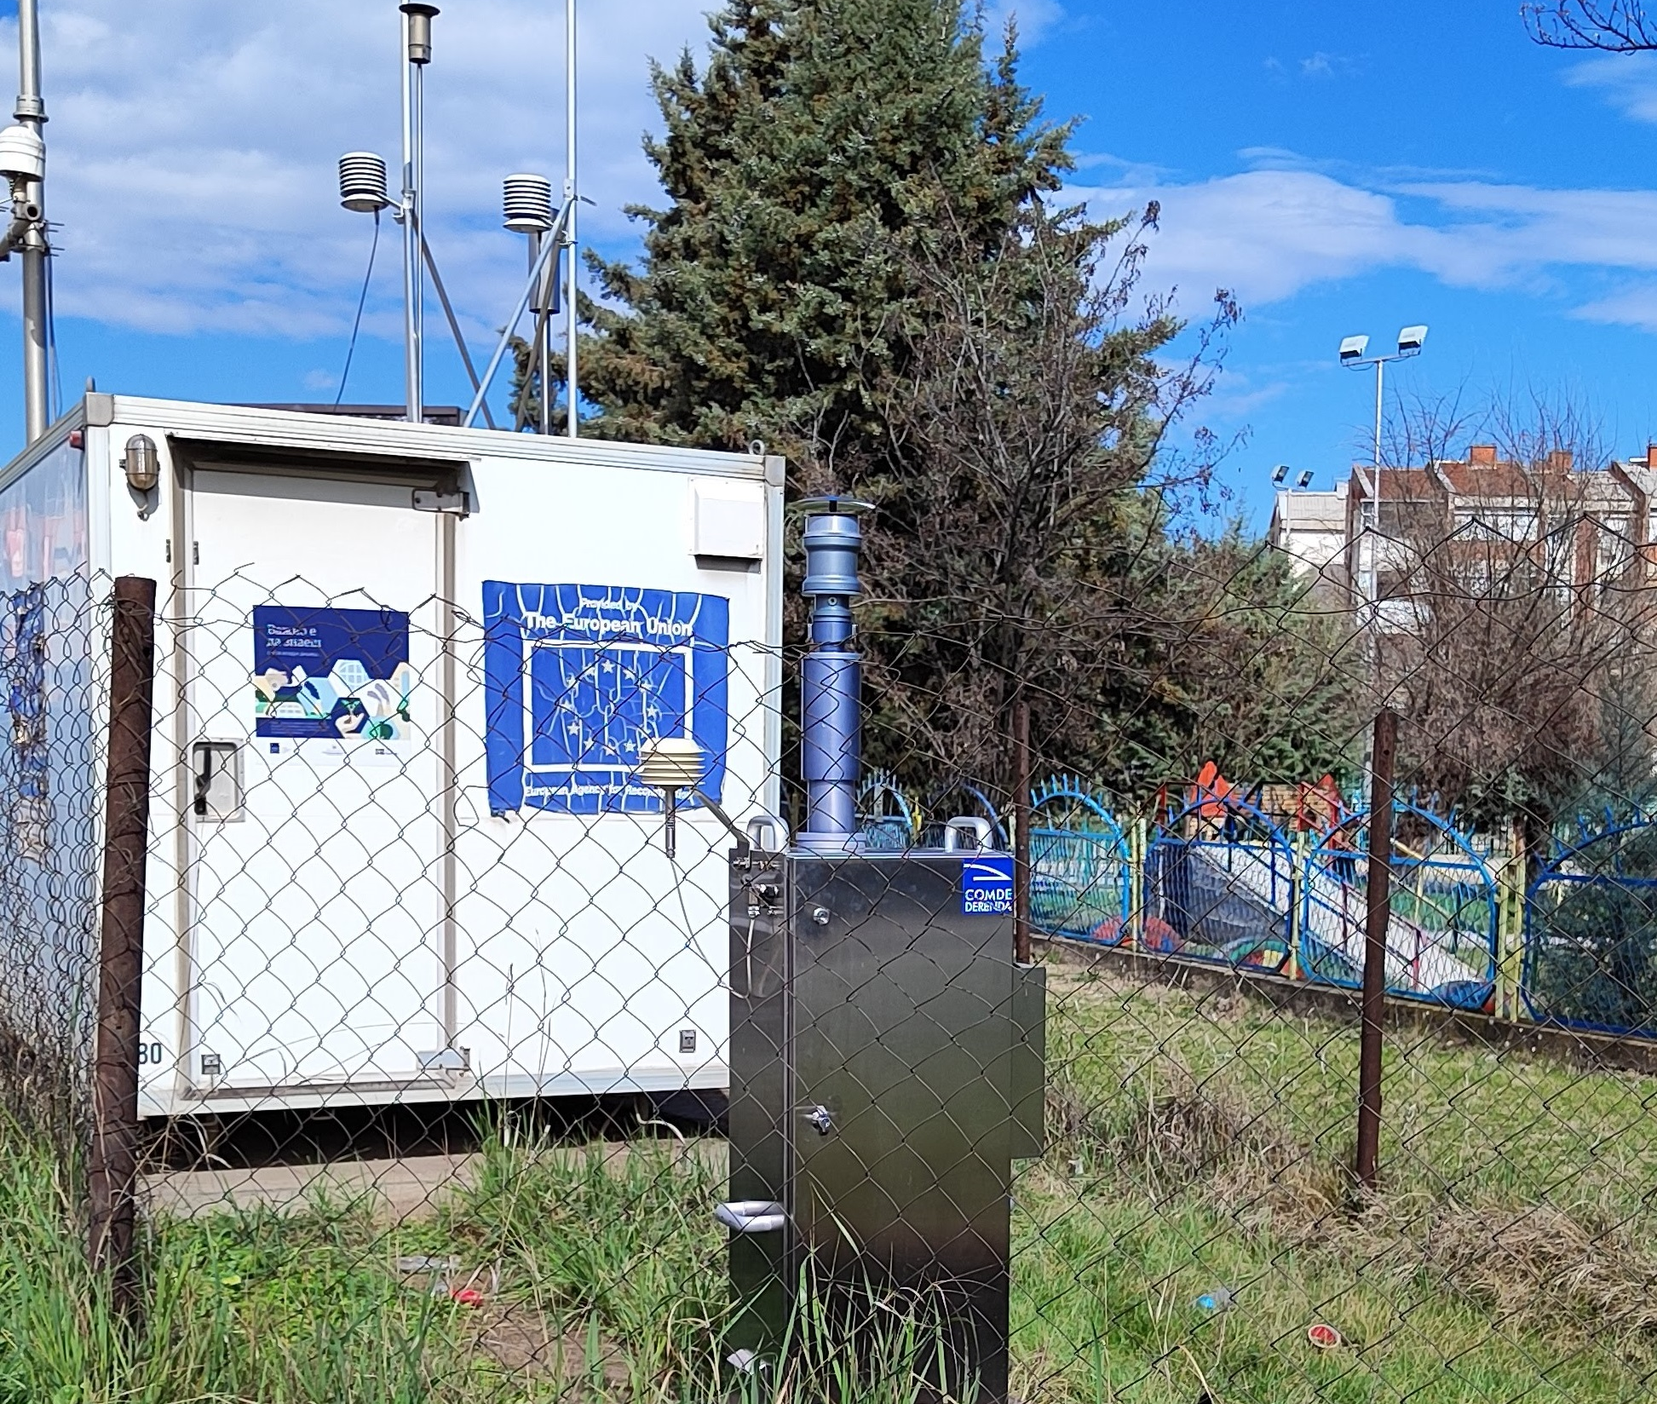
A science offer robust toolbox to assess the problem…
1
Standardized (EN 12341:2023) and flexible sampling techniques can provide reliable and comparable results in different conditions.
Flexibility provide room for adaptation to the different sampling goals and conditions.
Certified and automated equipment available allow improved accuracy and reduced sampling cost.

Slide 6
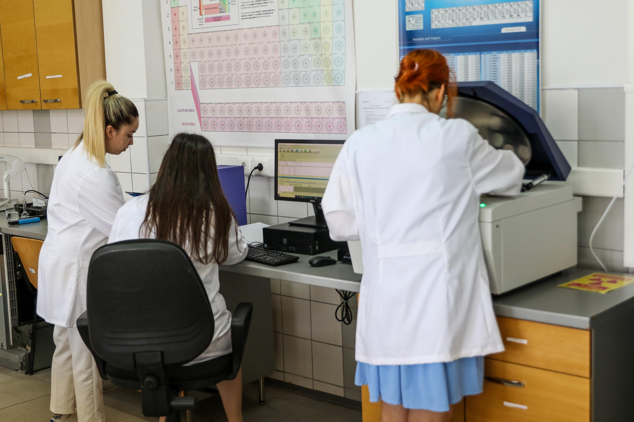
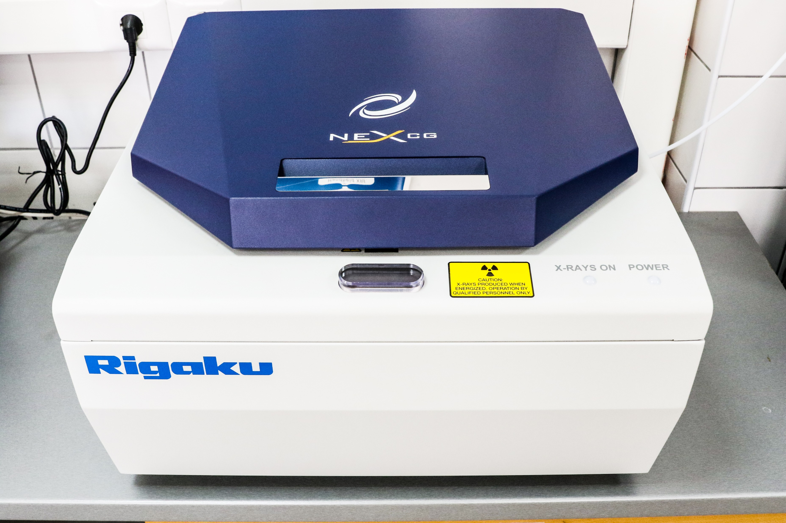
A science offer robust toolbox to assess the problem…
2
New analytical equipment and methods based on X-ray fluorescence spectrometers, supported with advanced multielement reference material allow fast, non-destructive (wasteless) and precise determination of particulate mater elemental composition.

Slide 7



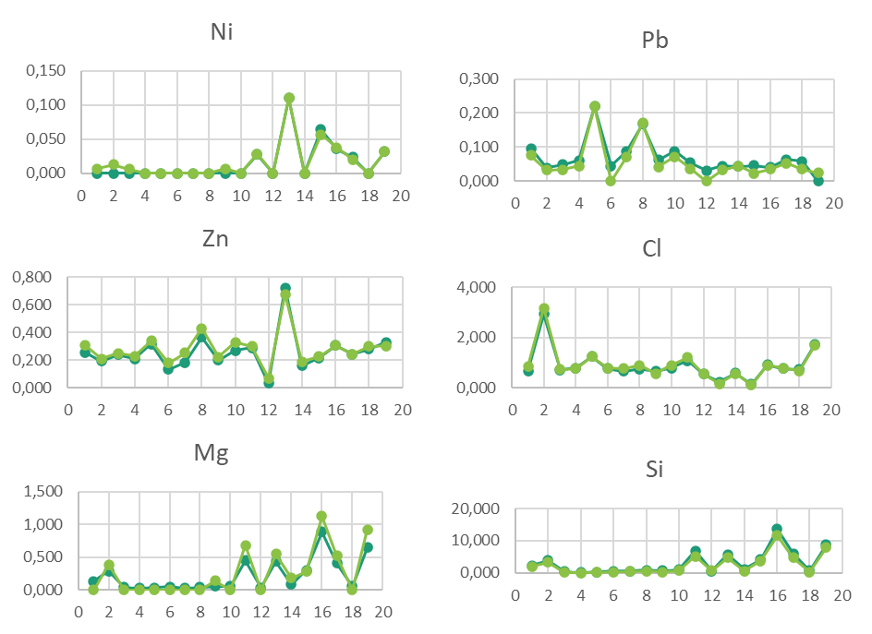
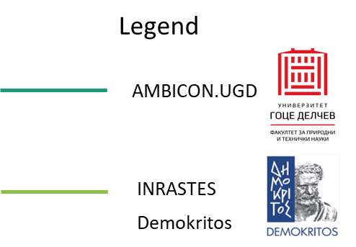
A science offer robust toolbox to assess the problem…
The availability of reference materials and field calibration devices provide robust quality assurance throughout all stages of the process.
Proficiency testing frameworks and interlaboratory comparisons enhance accuracy and foster trust, so ensuring the credibility and dependability of the generated data.
Our laboratory has accredited an analytical method for the examination of 29 elements, ranging from sodium to uranium, directly on filters in a pure helium atmosphere, in compliance with the US EPA IO-3.3 method.
3

Slide 8
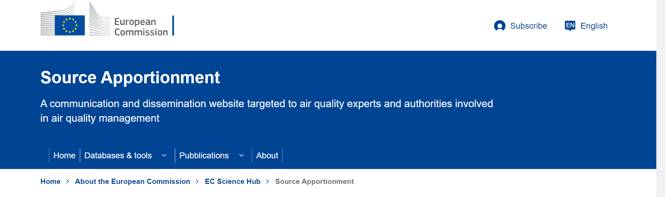
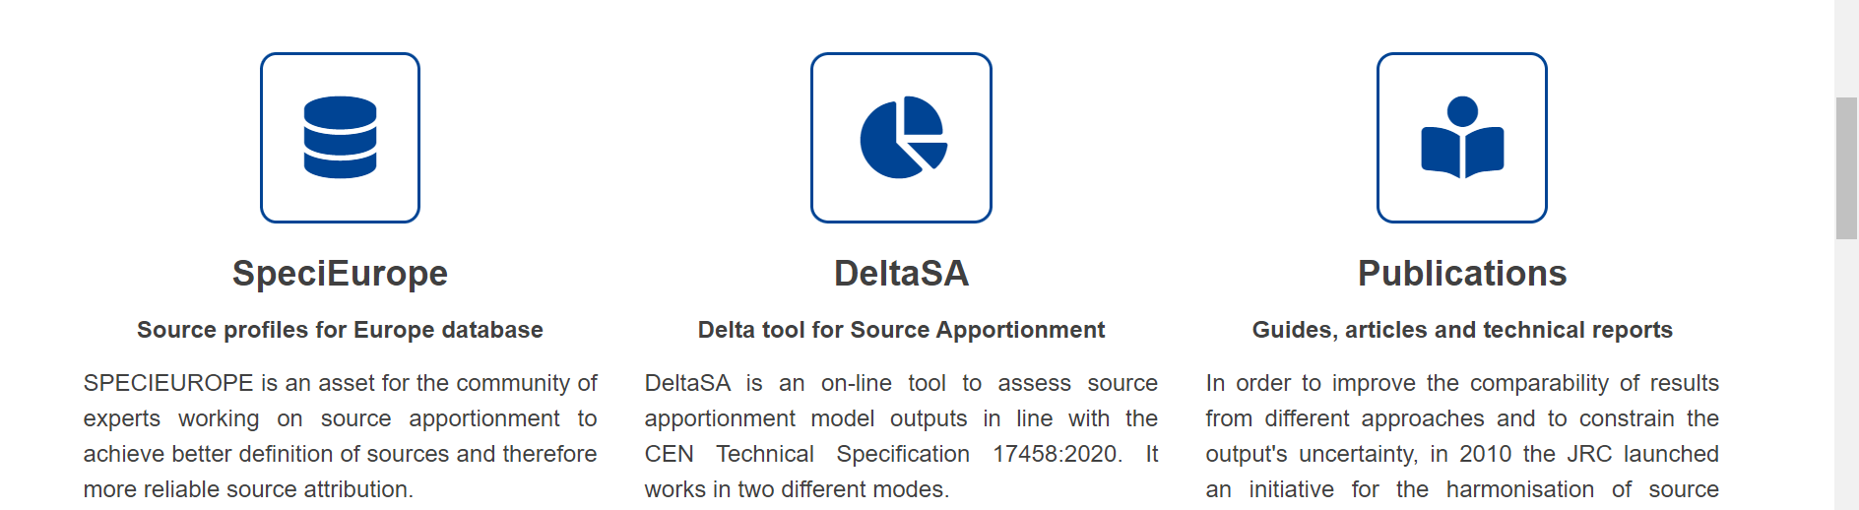
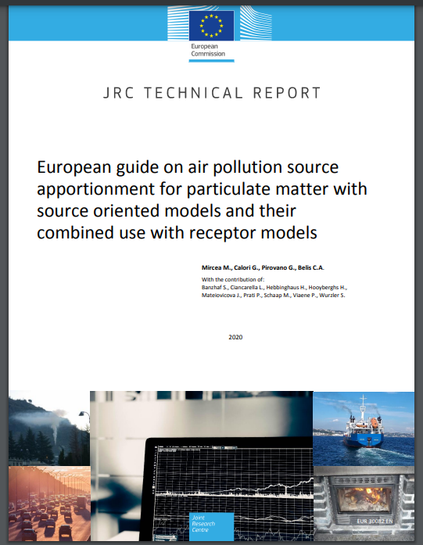
A science offer robust toolbox to assess the problem…
A comprehensive scientific database, along with detailed guidelines along with readily available modeling tools, facilitates the generation of reliable, accurate, and consistent results across diverse conditions.

Slide 9
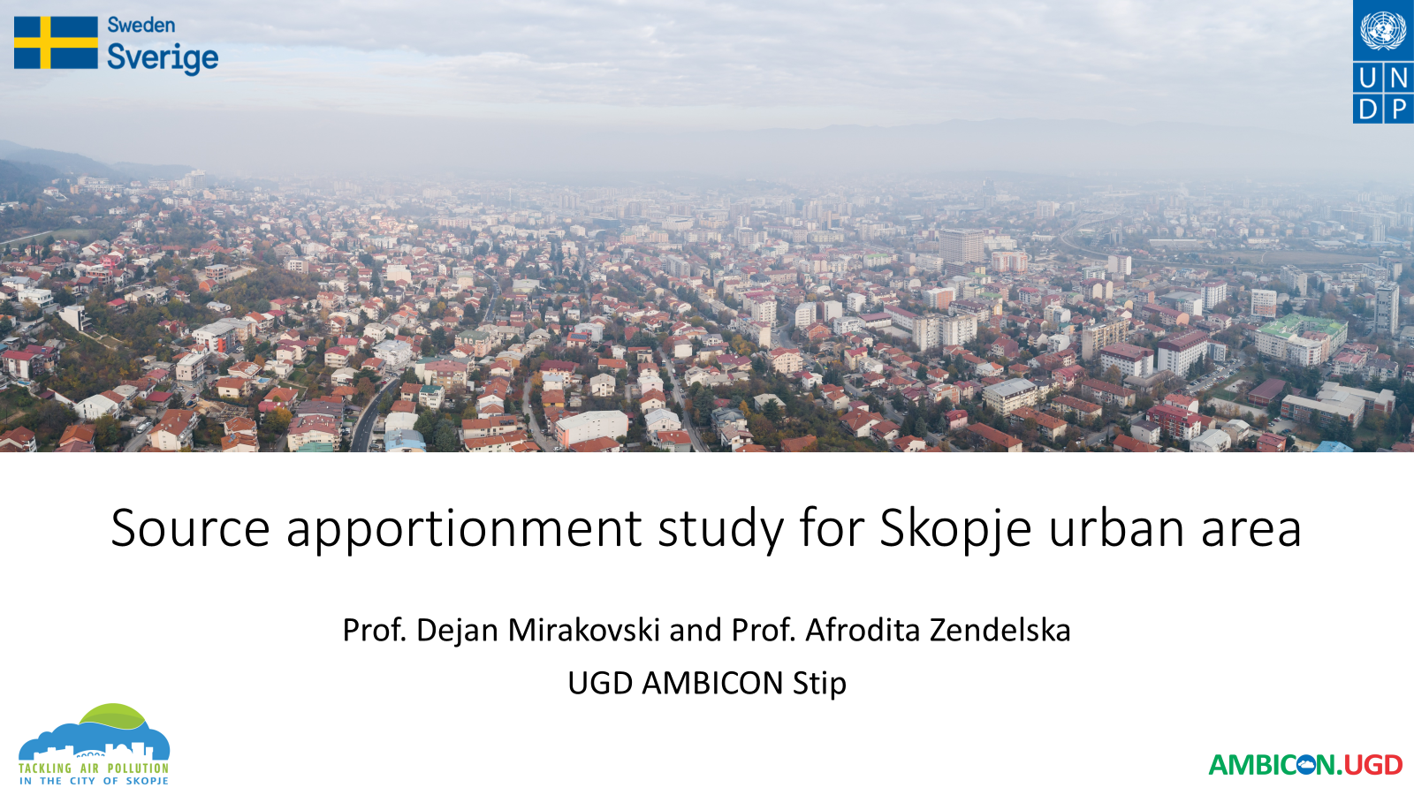
Source apportionment for Skopje Urban Area
The Source Apportionment Study for Skopje Agglomeration was preprepared by AMBICON UGD Lab, as a part of Tackling Air Pollution in the City of Skopje Project, implemented by UNDP-Skopje and SIDA- Sweden’s government agency for development cooperation, and supported by Ministry of Environment and Physical Planning and City of Skopje.
The primary objective of the Source Apportionment (SA) study for the Skopje Agglomeration was to obtain information about pollution sources and the extent to which they contribute to ambient air pollution levels, as an essential tool in the design of air quality policies, as required explicitly or implicitly for the implementation of the Air Quality Directives (Directive 2008/50/EC and Directive 2004/107/EC).
Notes:
And using the scientific approach available, we have prepared a Source Approtionment Study for Skopje aglomeration

Slide 10
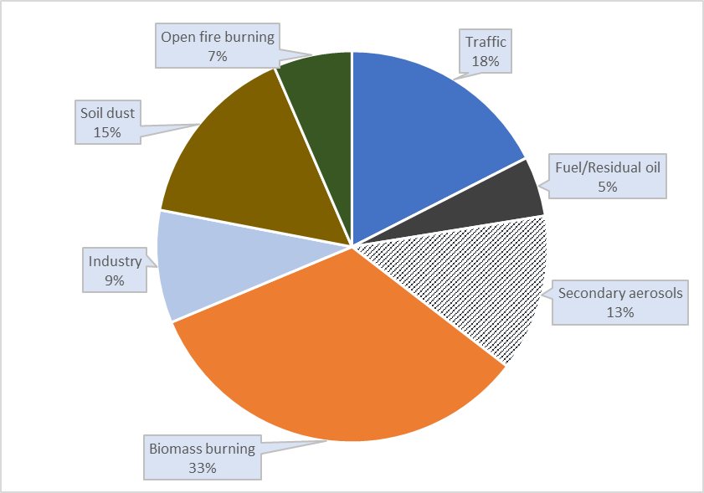
Relative annual contribution – Karposh urban background site

Slide 11
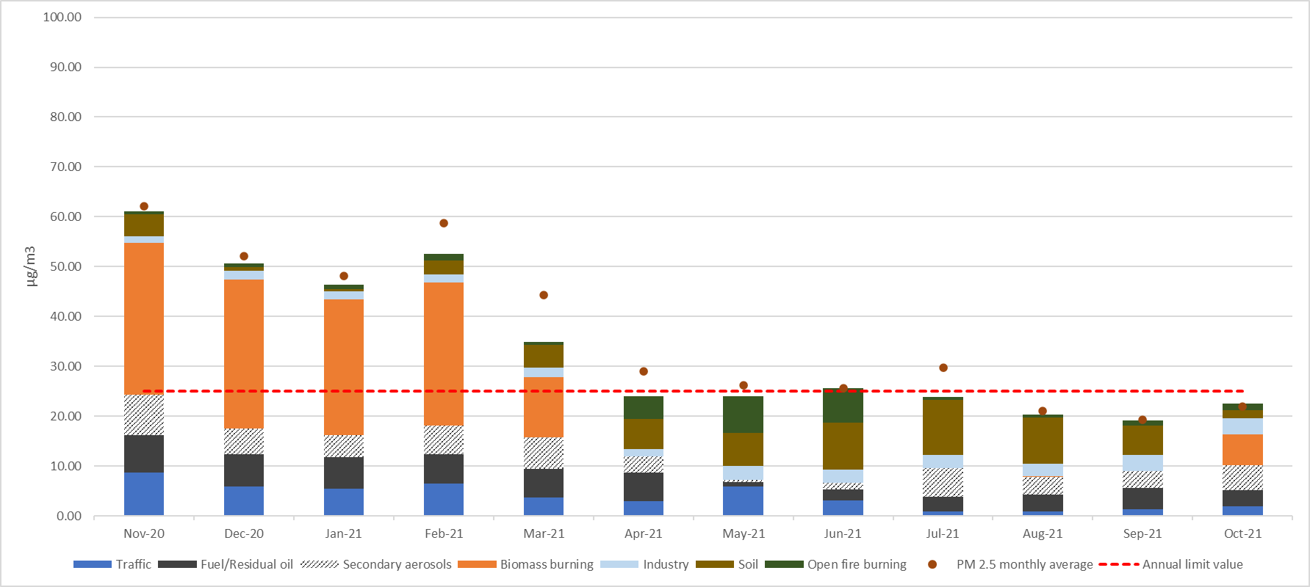
Monthly mass contribution – urban background site
Notes:
During the winter months biomass burning was a major source and although strictly seasonal, this source alone, contribute above the annual limit values. Traffic is the second most important source with consistent contribution over the year with exception of summer months. Soil dust has highest contribution over the summer months, and can contribute up to 45 % of total mass during those months. Open fire burning has largest contribution in spring and early summer months and can contribute up to 35 % of total particulate mass during this months. So for Skopje we have data abut main pollution sources in different seasons. It remain to us to act upon it.

Slide 12
Monthly mass contribution – urban background site
During the winter months (Nov, Dec, Jan, Feb and March) biomass burning was a major source, with average monthly contribution ranging between 12.16 and 30.42 μg/m³. This source alone, contribute above the annual limit values.
Notes:
During the winter months biomass burning was a major source, and although strictly seasonal, this source alone, contribute above the annual limit values.

Slide 13
Monthly mass contribution – urban background site
Traffic is the second most important source, with a consistent contribution between 0.86 and 8.69 μg/m³ during the year.
Notes:
Traffic is the second most important source with consistent contribution over the year with exception of summer months.

Slide 14
Monthly mass contribution – urban background site
Fuel/residual oil contribution range 0.84 to 7.54 μg/m³, while industrial sources exhibit slightly lower contribution ranging between 1.33 to 3.35 μg/m³. Both are consistent over the year.
Notes:
Fuel/residual is 3 largest source, while industrial sources exhibit slightly lower contribution, but both are consistent over the year.

Slide 15
Monthly mass contribution – urban background site
Soil dust has highest contribution over the summer months, ranging from 0.54 to 10.97 μg/m³ .
Notes:
Soil dust has highest contribution over the summer months, and can contribute up to 45 % of total mass during those months.

Slide 16
Monthly mass contribution – urban background site
Open fire burning is detectable over the entire year, with largest contribution in spring and early summer months and range from 0.56 and 7.32 μg/m³ .
Notes:
Open fire burning has largest contribution in spring and early summer months and can contribute up to 35 % of total particulate mass during this months. So for Skopje we have data abut main pollution sources in different seasons. It remain to us to act upon it.

Slide 17

“"The way to get started is to quit talking and begin doing." ” – Walt Disney
Notes:
And I will end my presentation with the quote from American animator and film producer,

