Slide 2


Beyond the Horizon
A Joint Foresight Exercise

Slide 3

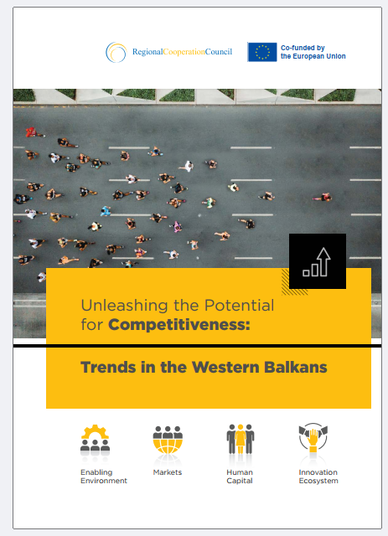
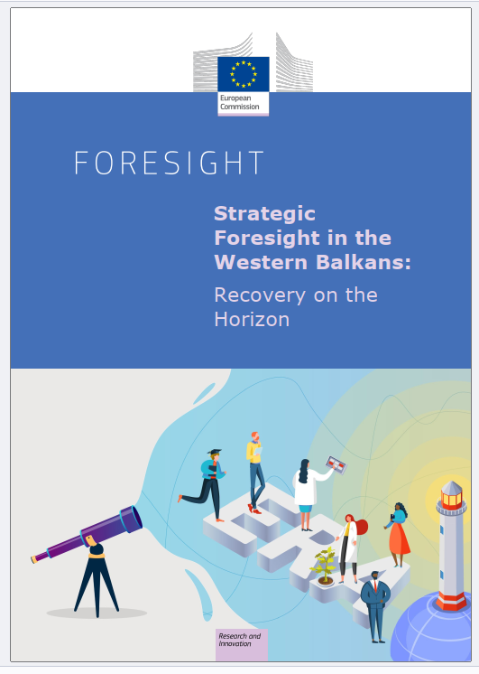
Strategic Foresight for the Western Balkans

Slide 4
Agenda
Strategic Foresight:
What is Strategic Foresight and
why do we need it?
Working with Trend Cards:
A Joint Foresight Exercise

Slide 5
What is Strategic Foresight?
And why do we need it?

Slide 6
Strategic Foresight:
Why do we need it?
Strategic Foresight empowers us to
prepare for multiple possible futures,
respond effectively when the unexpected happens,
proactively work towards a desired future,
make decisions that are resilient and forward-looking.

Slide 7
Strategic Foresight:
How does it work?
Strategic Foresight is a process for exploring potential futures:
Scan the Horizon
Explore Scenarios
Identify Implications
Shape the Future

Slide 8
Strategic Foresight: How does it work?
Strategic Foresight is a process for exploring potential futures:
Step 1: Gathering information to understand trends and signals of change.
Scan the Horizon
Explore Scenarios
Identify Implications
Shape the Future

Slide 9
Strategic Foresight: How does it work?
Strategic Foresight is a process for exploring potential futures:
Step 1: Gathering information to understand trends and signals of change.
Step 2: Creating narratives of the futures based on combinations of trends.
Scan the Horizon
Explore Scenarios
Identify Implications
Shape the Future

Slide 10
Strategic Foresight: How does it work?
Strategic Foresight is a process for exploring potential futures:
Step 1: Gathering information to understand trends and signals of change.
Step 2: Creating narratives of the futures based on combinations of trends.
Step 3: What threats or opportunities does each scenario present?
Scan the Horizon
Explore Scenarios
Identify Implications
Shape the Future

Slide 11
Strategic Foresight: How does it work?
Strategic Foresight is a process for exploring potential futures:
Step 1: Gathering information to understand trends and signals of change.
Step 2: Creating narratives of the futures based on combinations of trends.
Step 3: What threats or opportunities does each scenario present?
Step 4: Draft strategies to reach desired outcomes or prevent undesirable futures.
Scan the Horizon
Explore Scenarios
Identify Implications
Shape the Future

Slide 12
The Western Balkans by 2035
A Joint Foresight Exercise

Slide 13
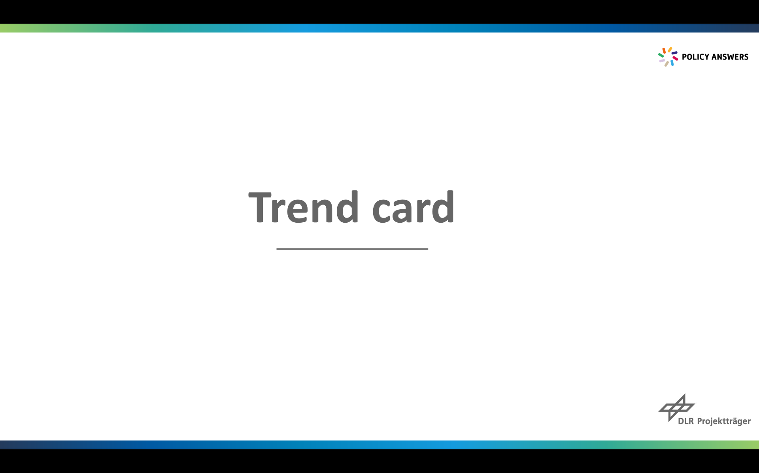
Instructions
Four tables, with two tables dedicated to each task.
Four rounds of 10 minutes each.
Each round, pick 3 trend cards from the trend card deck.
Before you start the task: Are these trends still valid?
Start the task.
After each round, rotate to a new table with a different task.

Slide 14
Task 1: Dream Big
Draw 3 trend cards from the pile.
Based thereon, envision the best possible future for
R&I in the WB.
Discuss as a group how these trends could shape
the best possible future.
Imagine what needs to happen today to make
that future a reality.

Slide 15
Task 2: Prioritize
Draw 3 trend cards from the pile.
Identify which trends will have the most significant impact
on the future of your organization or sector.
Rank the cards in order of importance based on
their potential impact.
Discuss and compare your ranking as a group.
Explore the reasons behind your ranking.

Slide 16
Task 3: Invent
Draw 3 trend cards from the pile.
Develop a future service, product, policy, or strategy
inspired by the trend cards.
Consider how these innovations could address
future challenges or leverage emerging opportunities.
Discuss potential EU-WB collaborations or
regional partnerships that could support your ideas.

Slide 17
Task 4: Connect the Dots
Draw 3 trend cards from the pile.
Explore how different trends might interact,
influence, or amplify each other.
Identify any synergies or conflicts that could arise
from the interaction of these trends.
Consider what new opportunities or risks
might emerge from these interactions.

Slide 18
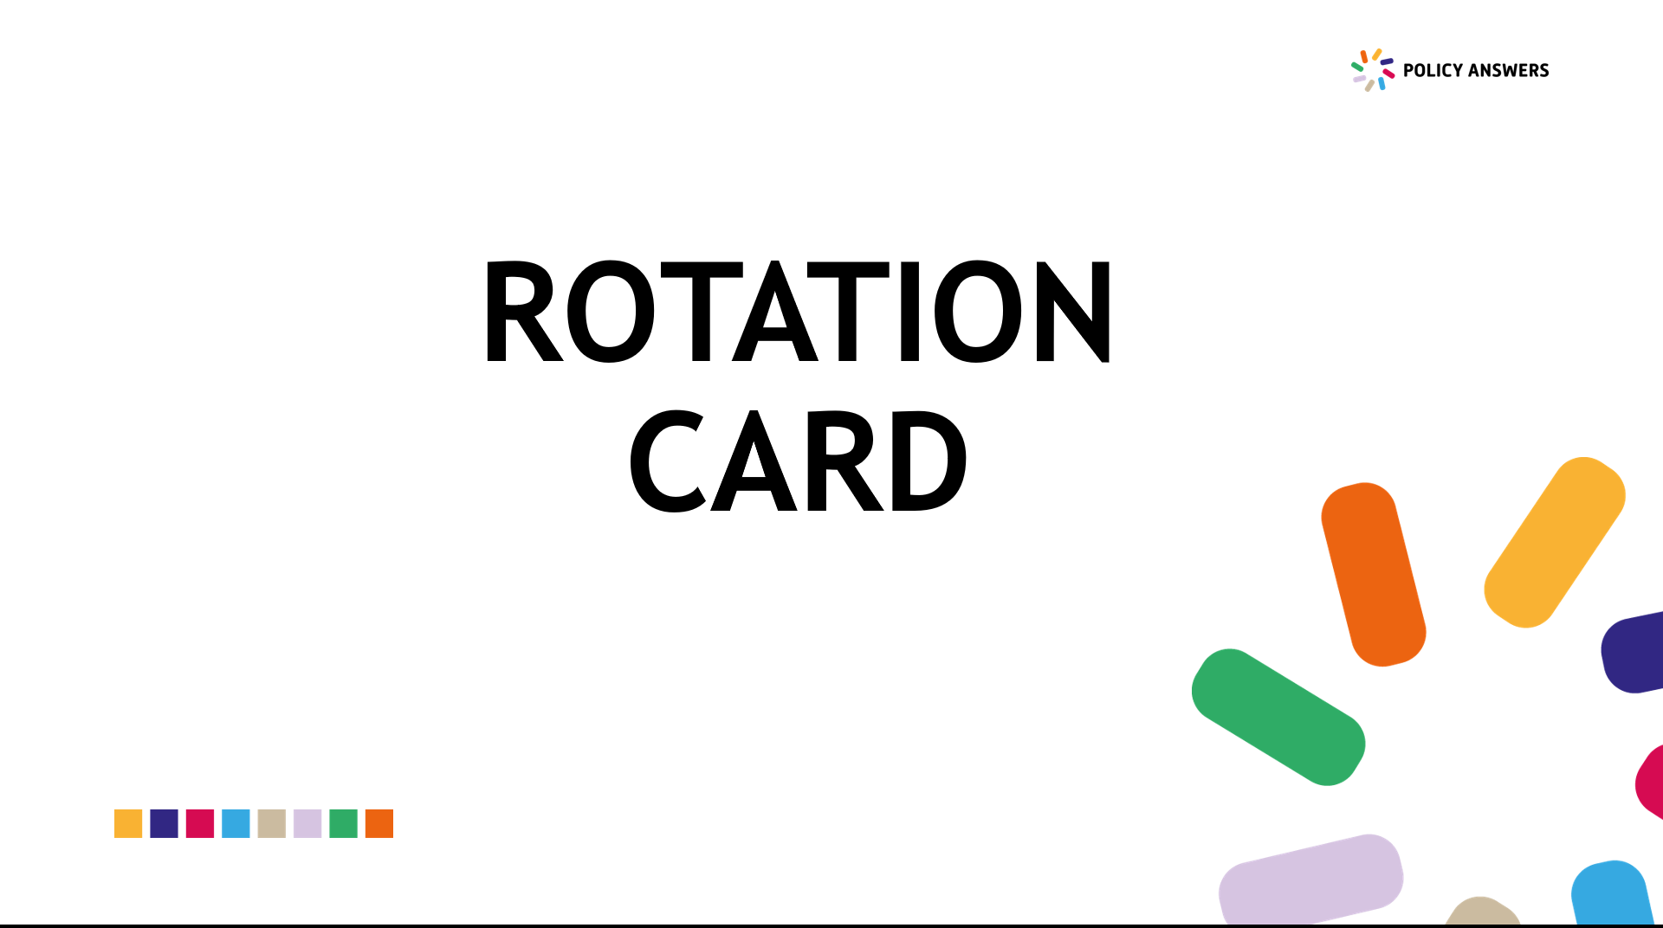
Rotation
At the end of each round, you’ll unveil a card
from the “rotation stack”.
This card will tell you which table to move to next.
With each rotation, you’ll be joining
a new group of participants.

Slide 19
Reflection
Please share any key takeaways or interesting ideas
that came up during your discussions:
Are there “new” trends that have emerged only recently?
Was there a trend or insight that surprised you?
Were there any potential risks or opportunities
that sparked new ideas?
How can we apply what we’ve learned tonight?
…

Slide 20
Dr. Julia Schmälter
DLR Projektträger
Contact
Julia.Schmaelter@dlr.de
THANK YOU!
Find us on social media
https://www.facebook.com/WBInfoHub
www.westernbalkans-infohub.eu
https://twitter.com/WBInfoHub
policy-answers@westernbalkans-infohub.eu

