Slide 1


POLICY ANSWERS
“R&I POLICY making, implementation ANd Support in the WEsteRn BalkanS”:
IZGRADNJA KAPACITETA U OBLASTI ISTRAŽIVANJA, RAZVOJA I INOVACIJA NA ZAPADNOM BALKANU
Dr Sanja Popović, Institut Mihajlo Pupin
Notes:
1

Slide 2














The POLICY ANSWERS consortium
Coordinator: Centre for Social Innovation (ZSI) from Austria, ZSI
14 beneficiaries from:
Albania
Bosnia and Herzegovina
Kosovo*
Montenegro
North Macedonia
Serbia
Austria, Croatia, Germany and Italy
* This designation is without prejudice to positions on status, and is in line with UNSCR 1244/1999 and the ICJ Opinion on the Kosovo declaration of independence.
Notes:
Just for the newcomes.
Representing POLICY ANSWERS consortium.
ZSI coordinator.
Speaker: from partner DLR

Slide 3
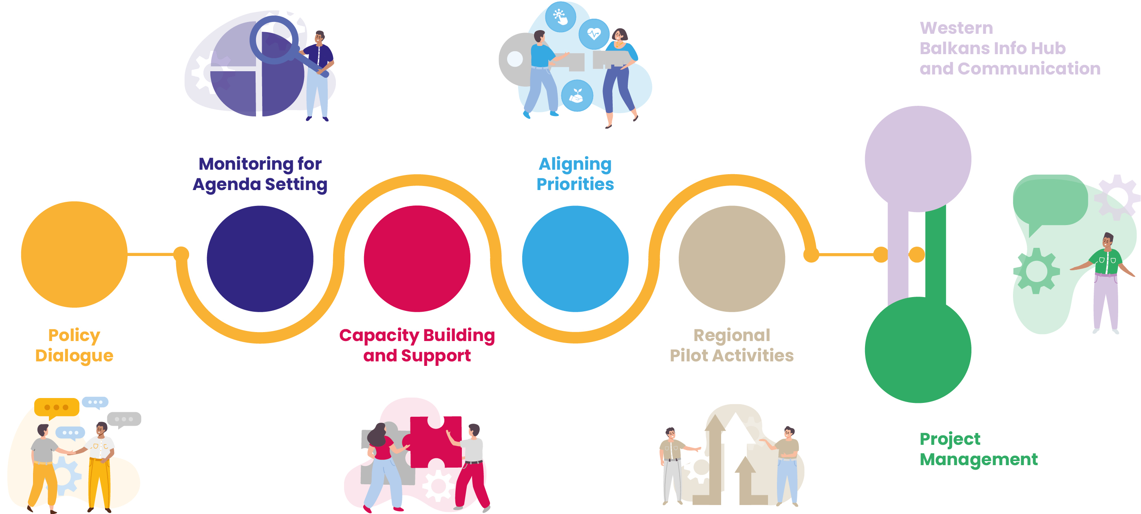
Project overview
Notes:
We work as a project on 7 Work Packages and regularly present in this forum, so the following presentation will focus on the latest activities and current updates.

Slide 4
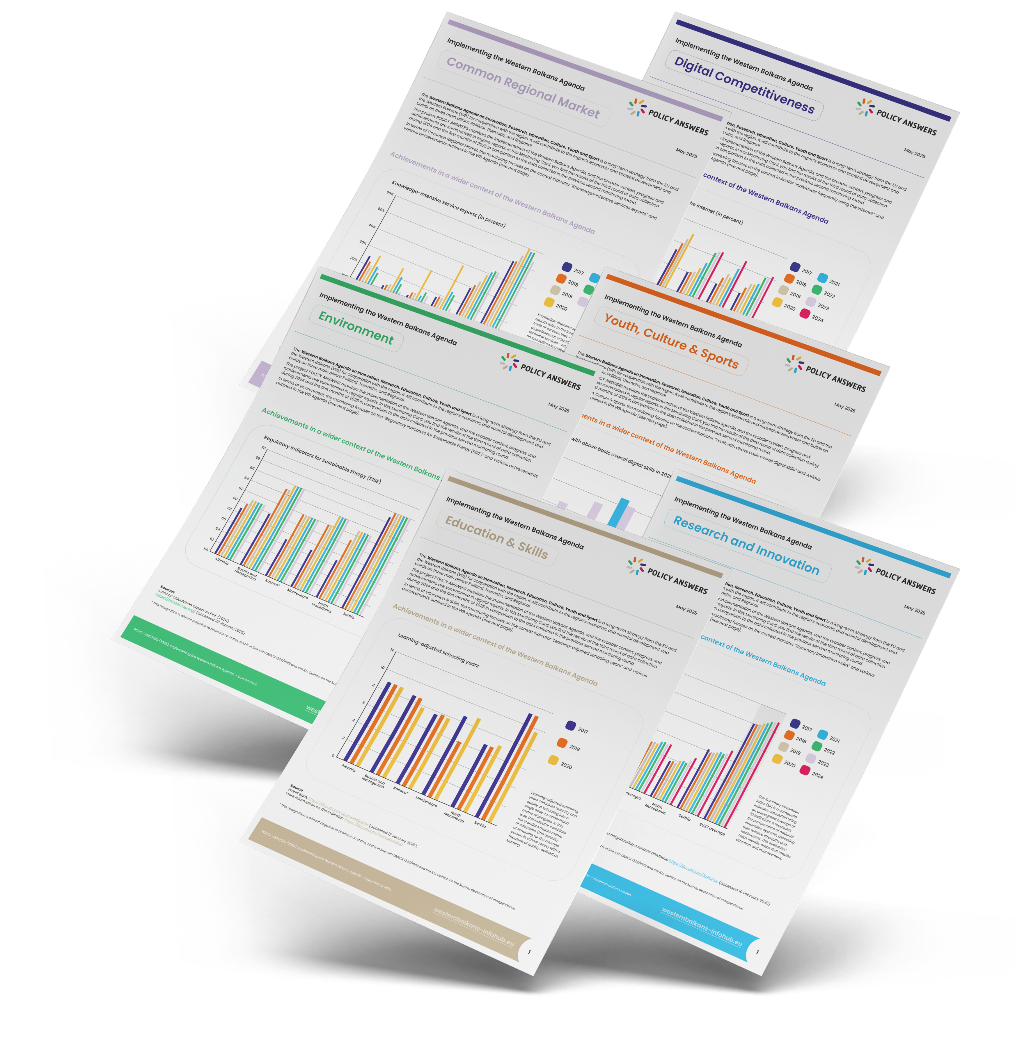
Monitoring of the
Western Balkans Agenda
3rd monitoring round:
> 2025 edition (progress compared to baseline 2023)
Research and Innovation
Digital Competitiveness
Environment
Youth, Culture & Sports
Education & Skills
Common Regional Market

Slide 5
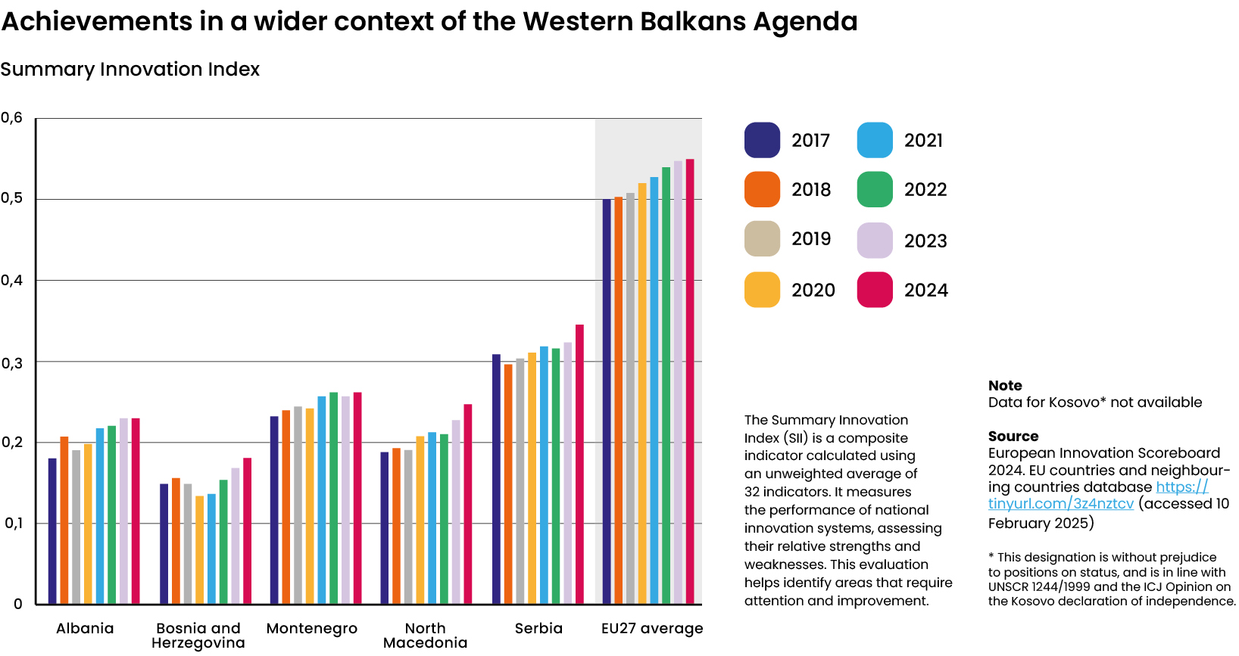

Slide 6

The capacity building activities are defined for each of the WB economies based on a standardised methodology and reflecting the respective priorities for implementing the WB Agenda. Therefore, there are six tasks:
Task 3.1 Capacity building and implementation in Albania
(Lead: NASRI, supported by ZSI)
Task 3.2 Capacity building and implementation in Bosnia and Herzegovina (Lead: UNIBL, UNSA)
Task 3.3 Capacity building and implementation in Kosovo
(Lead: RIINVEST)
Task 3.4 Capacity building and implementation in Montenegro
(Lead: STP MNE)
Task 3.5 Capacity building and implementation in North Macedonia (Lead: FITD, support: MIR)
Task 3.6 Capacity building and implementation in Serbia
(Lead: IMP)

Slide 7
Updated Capacity Building Programme 2024/2025
KOSOVO*
Training of researchers for preparation of applications and implementing projects in Horizon Europe.
Technical Assistance for the Ministry of Education, Science, Technology and Innovation & the National Research Council through providing inputs for
New National Research Programme and increasing funding sources for R&I.
Support in advancing curricula with thematic priority areas at university level.
Support of increasing cooperation between the private sector and institutions
in the field of research and innovation.
Organisation of workshop and provision of methodology guideline for project identification and preparation in light of the EU Economic and Investment
Plan for the Western Balkans.
Creation of a Coordination Forum of Quadruple Helix to create synergy amongst key actors.
Technical Assistance on the Implementation of the WB Green Agenda.
Monitoring of the implementation of the Digital Agenda.
Technical Assistance for the Ministry of Health.
ALBANIA
Training programme at universities to prepare and implement GEPs.
Support participation in Horizon Europe.
Support to promote EU funding for companies.
Supporting WB Agenda requirements on S3 implementation.
Promotion of innovation opportunities related to the blue economy.
Mapping of research infrastructure
BOSNIA AND HERZEGOVINA
Support for preparation of Horizon Europe partnerships and proposals.
Capacity building in research management and administration.
Capacity building in monitoring and evaluation.
Building and strengthening the academia-industry linkages.
Assistance in (co)creating policy documents.
Support to Open Science.
Support to the development of a Smart Specialisation Strategy.
NORTH MACEDONIA
Policy Design, Coordination, Monitoring and Evaluation (Research, Development and Innovation (RDI), education and culture specific).
  Setting the stage: policy design.
  Institutions in practice: coordination & collaboration.
  Performance management: monitoring & evaluation.
Strengthening capacities of the business sector for digital skills and innovations
Promoting peer learning & exchange of best practices for TT, innovation and twin transition
CB for FITD representatives for financial instruments
Supporting implementation of S3 Action Plan
MONTENEGRO
Training for Preparation of Applications for Horizon Europe Projects.
Training for Implementing Horizon Europe Projects in Montenegro.
Training for implementation of the Circular Economy Principles in Montenegro.
Training to Support the Development of Sustainable Agriculture and the Food Value Chain in Montenegro.
SERBIA
Strengthening the capacity of the business sector for digital skills.
Green Transformation: New skills required to master the green transition.
Green transition (advanced level).
Training sessions on Programme evaluation: Evaluation practices in policies and programmes.

Slide 8



Activities in Albania
CONCLUDED
ONGOING
ON HOLD
Capacity Building Activity | Status and results in 2024/25
1. Training programme at universities to prepare and implement Gender Equality Plans | Concluded before.
2. Support to participation in Horizon Europe | Ongoing. 30 events organised with total reach of 500 people. Partnership with other project developed
3. Support to promote EU funding for companies | Concluded. 22 companies have received consultations for EU funding support. Project proposals submitted to 3 Calls for EU Funding
4. Supporting WB Agenda requirements on S3 implementation | Concluded before.
5. Promotion of innovation opportunities related to the blue economy | Concluded before.
6. Mapping of research infrastructure | Ongoing, not started yet.

Slide 9
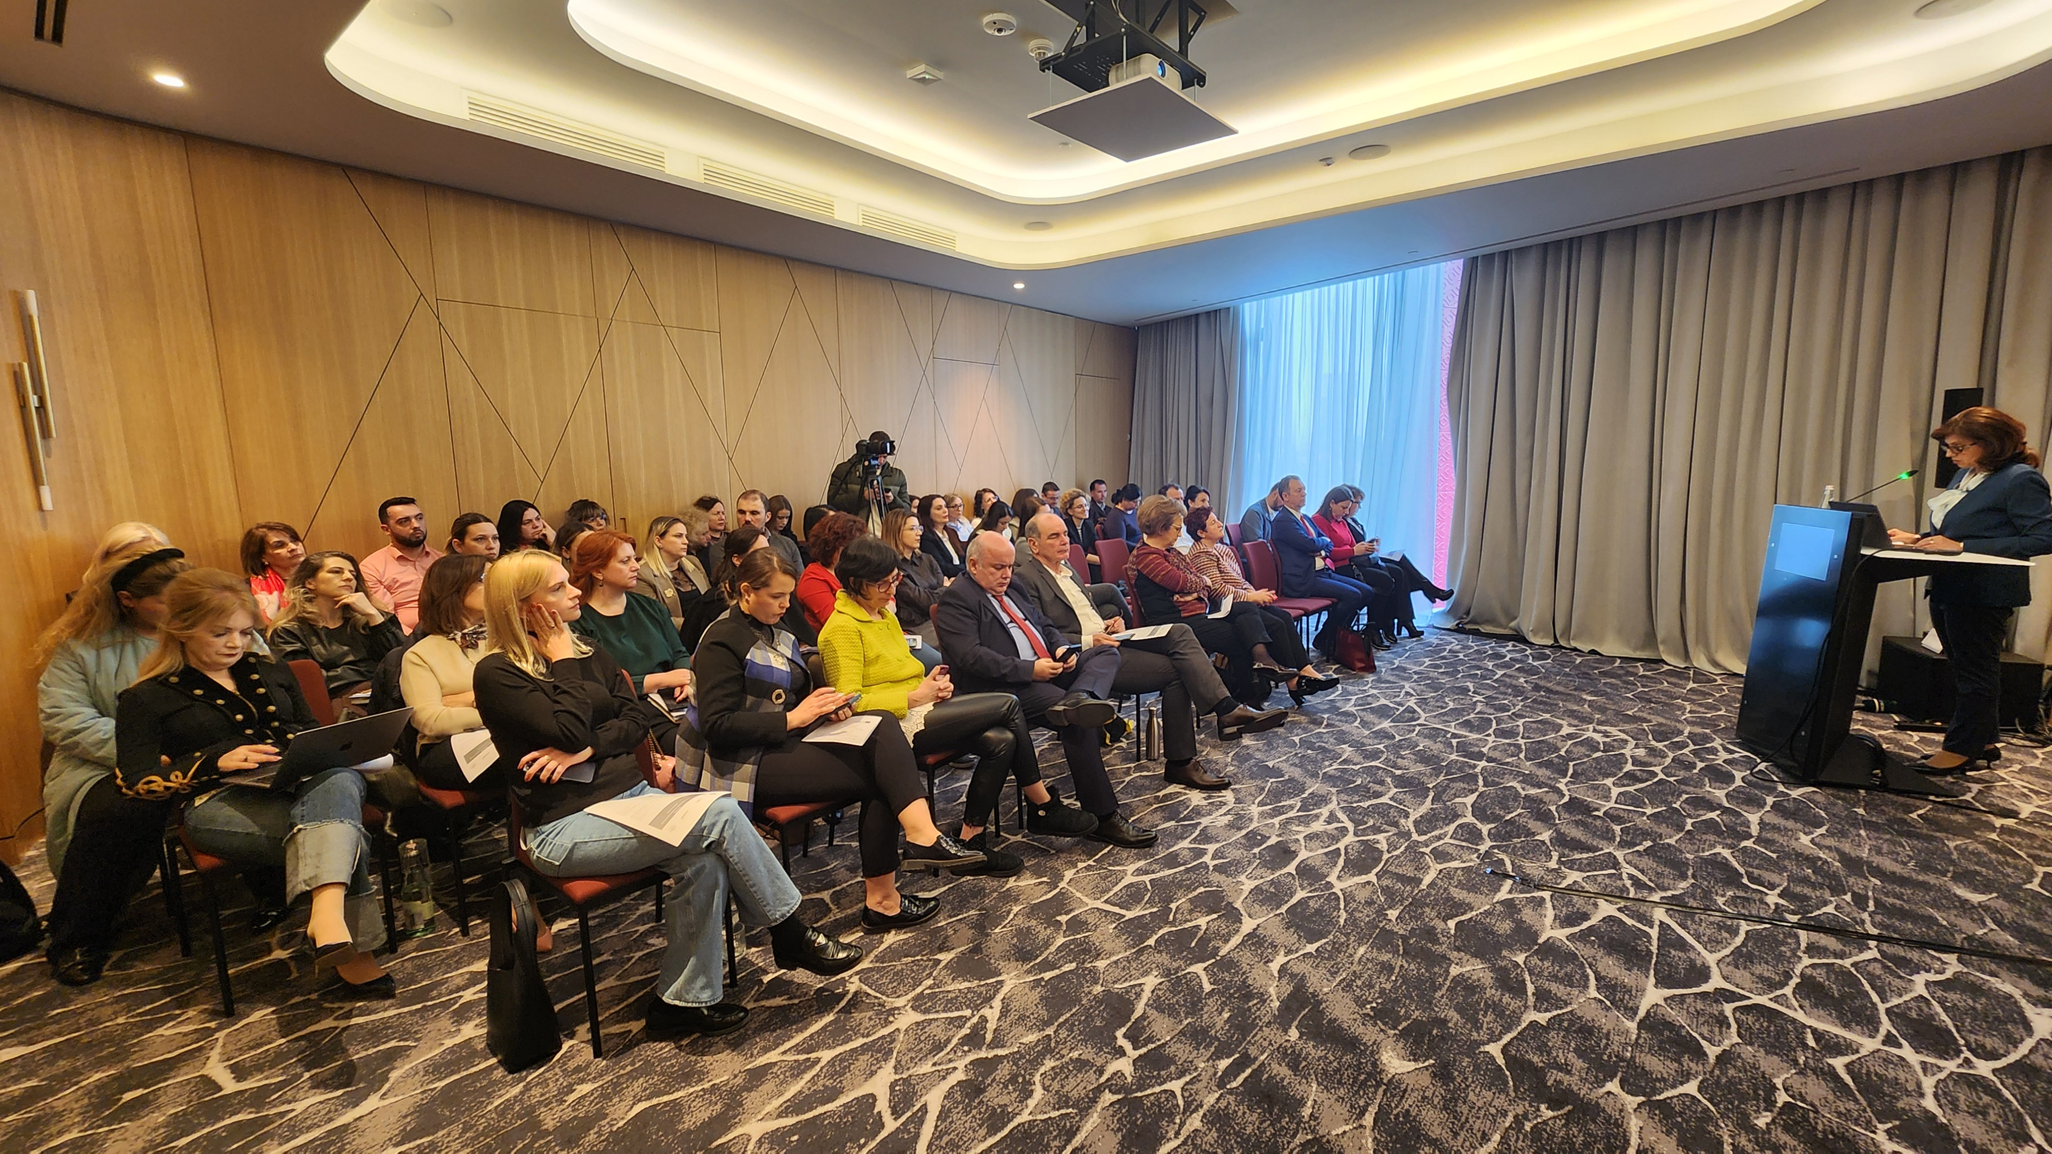
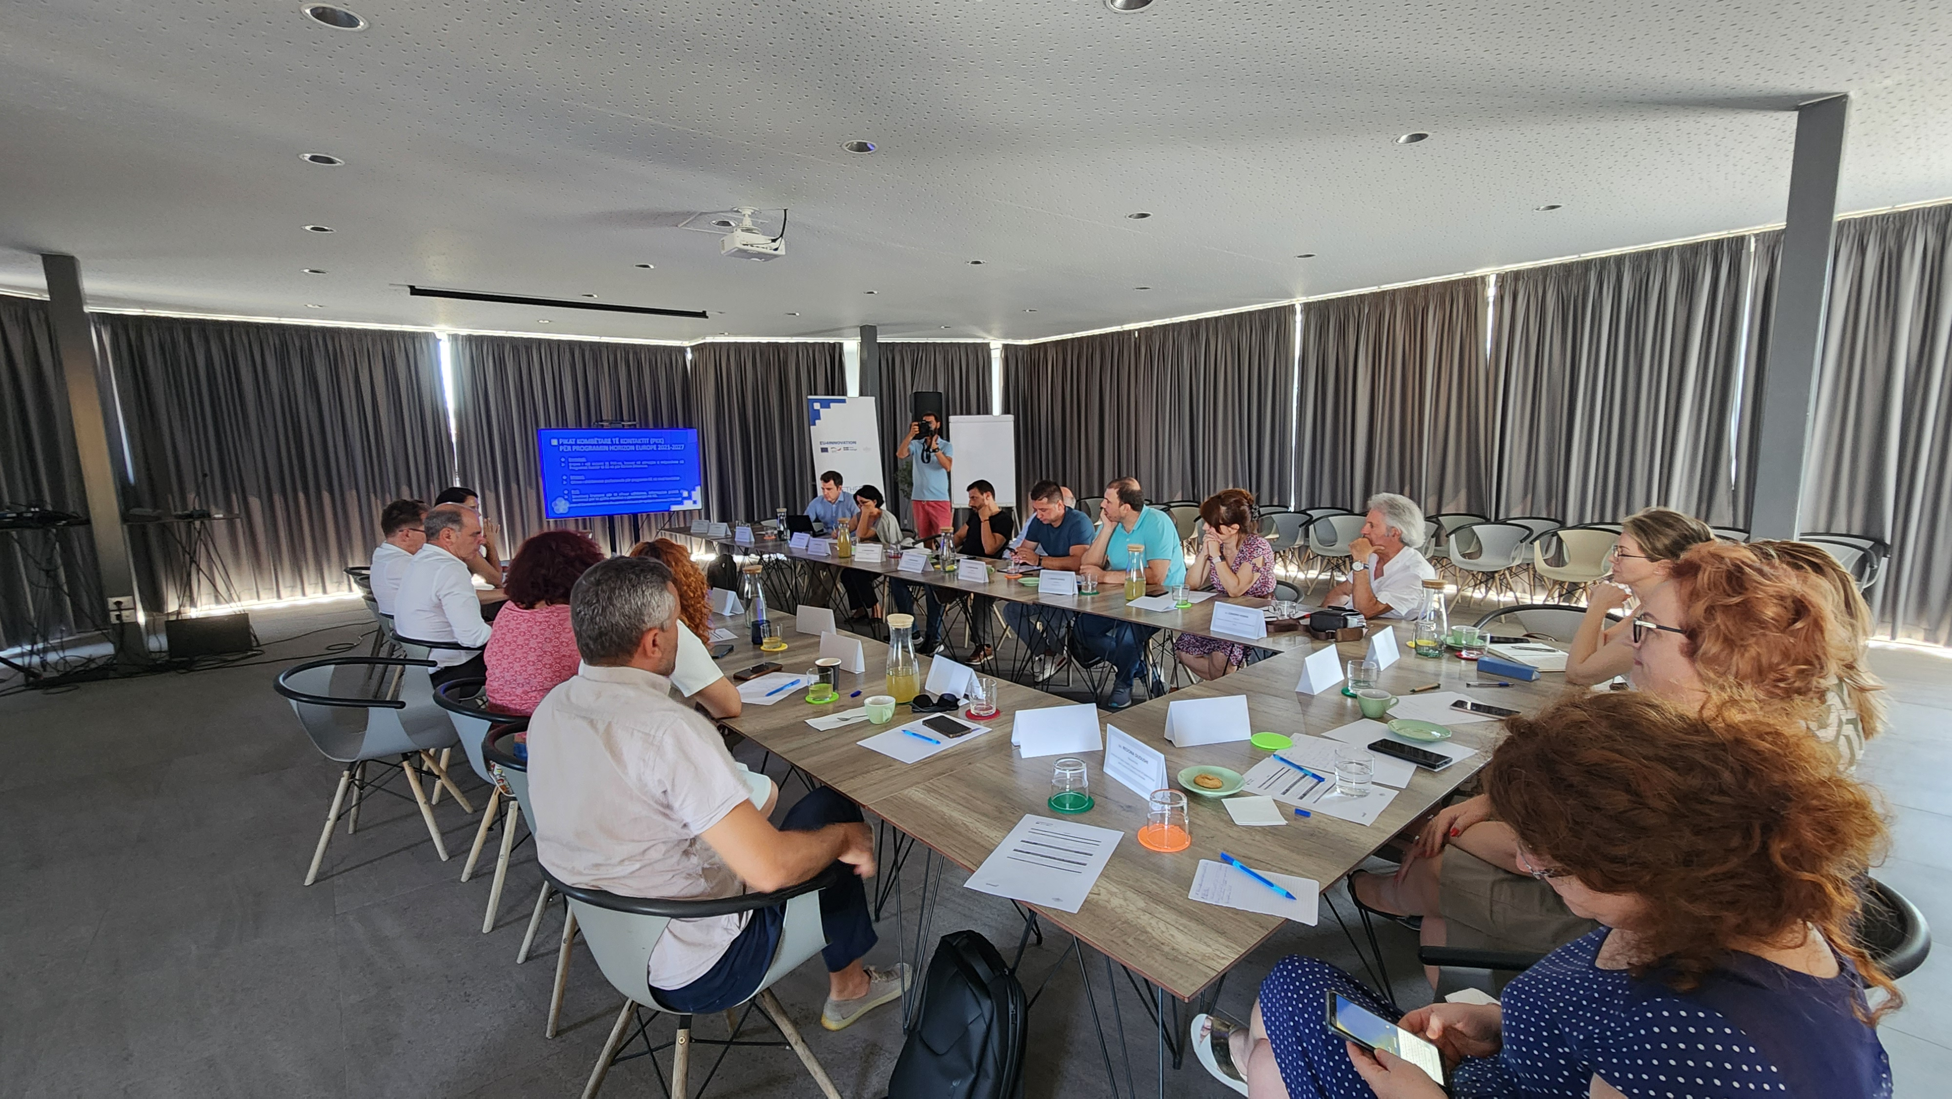
Highlights from Albania
EIT Info Day 27.2.25
HE Info Day at Polis University 14.2.24
Scientific Symposium on Careers Beyond Academia and Transferable Skills for PhDs Date: 14 April 2024, Tirana
2nd NCP Workshop at EU4I 15.7.24
HE Info Day at ASIG 8.4.24

Slide 10
Activities in Bosnia and Herzegovina
CONCLUDED
ONGOING
ON HOLD
Capacity Building Activity | Status and results in 2024/25
1. Support for preparation of Horizon Europe partnerships and proposals | Concluded. Two HE projects gained with UNIBL as coordinator and one project gained in the Horizon WIDERA 2023 Twinning programme
2. Capacity building in research management and administration | Ongoing. UNIBL set up a project management office at the Faculty of Philosophy. UNSA created digital materials for five on-line modules and one study visit to the University of Split which resulted in one joint COST action
3. Capacity building in monitoring and evaluation | Concluded. One workshop realised in 2024 by UNIBL mainly attended by the representatives of the Ministry of Science Technology Development and Higher Education of the of the Republika Srpska
4. Building and strengthening the academia-industry linkages | Concluded. UNSA organised two-days workshops for the researchers and innovators; provided support to scientific and research incubator
5. Assistance in (co)creating policy documents | Concluded. Seven drafted policy documents by UNSA
6. Support to Open Science | Ongoing. UNIBL organised a two-day event for up to 40 participants, lecture, training and two-day workshop on Open Science and IPR; new topic on digital libraries to be implemented in 2025. UNSA enabled open access to journals at the UNSA e-CRIS database
7. Support to the development of a Smart Specialisation Strategy. | On hold

Slide 11
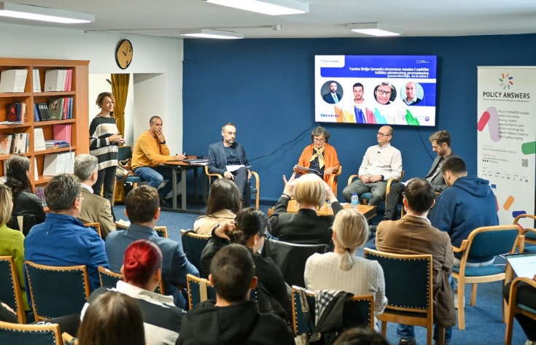
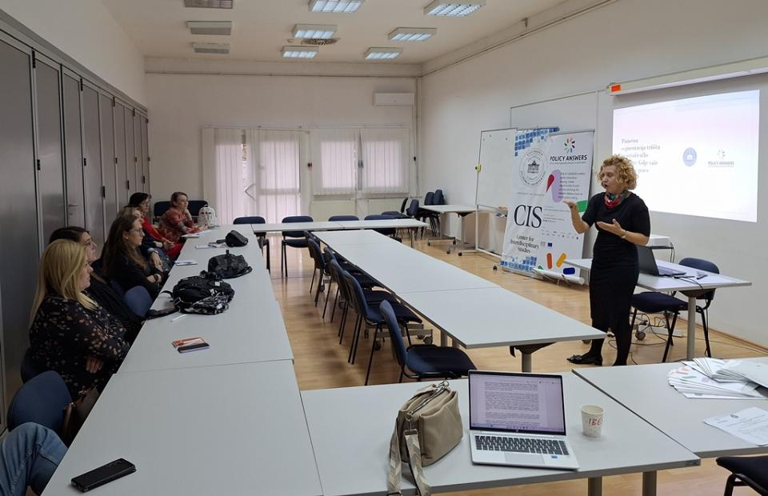
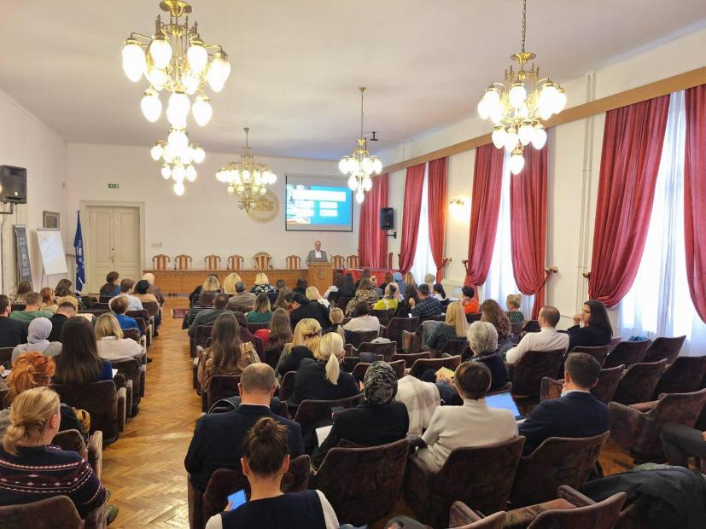
Capacity Building Activities Bosnia and Herzegovina- Highlights from 2024 | University of Banja Luka and Sarajevo
Open Science and Intellectual Property Protection,
UNIBL 2024
Workshop on Research-Industry
Collaboration,
UNSA, 2024
Project Management Workshop,
UNSA 2024

Slide 12
Activities in Kosovo
CONCLUDED
ONGOING
ON HOLD
Capacity Building Activity | Status and results in 2024/25
1. Training of researchers for preparation of applications and implementing projects in Horizon Europe | Concluded before
2. Technical Assistance for the Ministry of Education, Science, Technology and Innovation & Nat. Res. Council through inputs for New National Research Programme | Concluded before
3. Support in advancing curricula with thematic priority areas at university level | Concluded. Report on how to advance University curricula, teaching methods and resources on Digital and Green Transition. Short video with key messages was promoted on social media.
4. Support for increasing cooperation between the private sector and R&I institutions | Ongoing. A report with policy recommendations on the Draft Law on Innovations and the Innovation Fund created.
5. Organisation of workshops and provision of methodology guideline for project preparation in light of the EU Economic and Investment Plan for the WB | On hold.
6. Creation of a Coordination Forum of Quadruple Helix to create synergy | On hold.
7. Technical Assistance on Implementation of the WB Green Agenda | Ongoing. Green Talks video series produced; Panel held (40 participants); Circular economy study completed; Green School (3rd edition) implemented; Approach presented at POLIS University, Tirana
8. Monitoring of the implementation of the Digital Agenda | Ongoing. Report on State of Play regarding Digital Transformation created and promoted.
9. Technical Assistance for the Ministry of Health | Concluded. Report “An absent Therapy for Health Financing” on health underfinancing created and widely promoted along with the infographics and videos.

Slide 13
Activities in Montenegro
CONCLUDED
ONGOING
ON HOLD
Capacity Building Activity | Status and results in 2024-2025
Training for preparation of applications for Horizon Europe projects | Concluded before
Training for implementing Horizon Europe projects in Montenegro | Concluded before
Training for implementation of circular economy principles in Montenegro | Concluded. Two part training was organised in November and December 2024. 16 participants attended/12 participants completed
Training to support the development of sustainable agriculture and the food value chain in Montenegro | Ongoing. Three training were organised in 2025 in Berane, Niksic and Tivat. 22 participants received certification

Slide 14
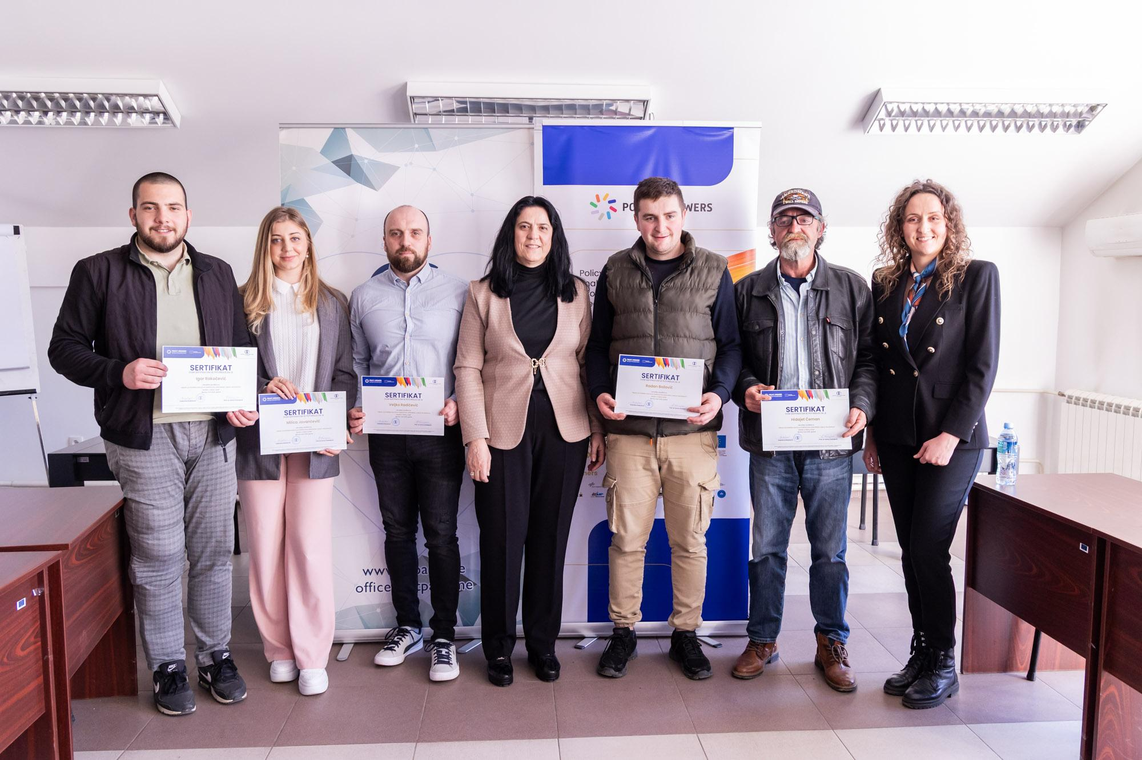
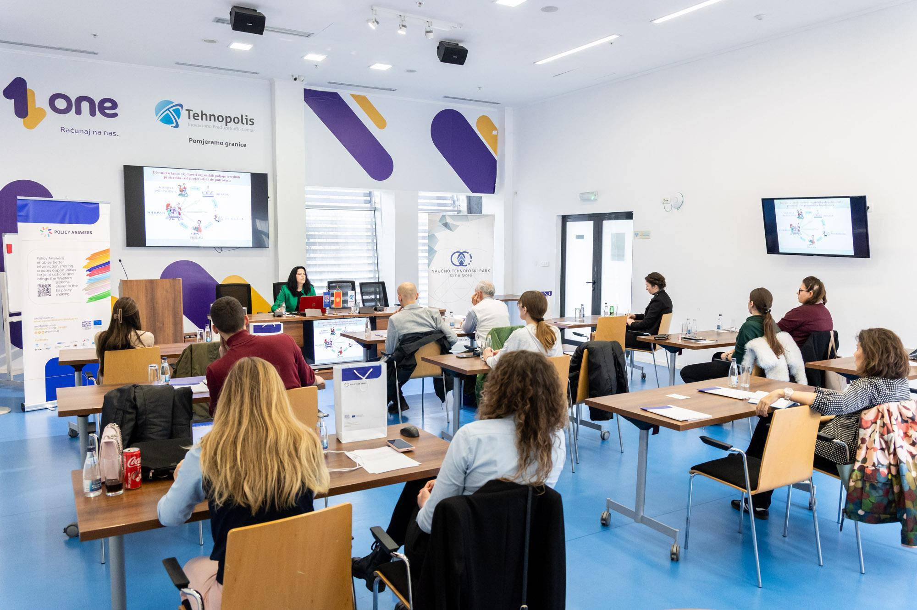
Highlights from Montenegro
Trainings on Sustainable Agriculture
Berane, 2025.
Niksic, 2025.
Video 1: Participants’ impressions from Berane: https://youtu.be/GvqiXiMGPYE
Video 2: Participants’ impressions from Nikšić: https://youtu.be/bR-6CGLPvuY

Slide 15
Activities in North Macedonia
CONCLUDED
ONGOING
ON HOLD
Capacity Building Activity | State of implementation
Policy Design, Coordination, Monitoring and Evaluation | Ongoing. Study visit to Oxford & London in February 2025, dissemination of the information gathered in the study visit at series of the meetings with local stakeholders.
Strengthening capacities of the business sector for digital skills and innovations | Ongoing, not started yet
Promoting peer learning & exchange of best practices for Technology Transfer, innovation and twin transition | Ongoing. Preparation for the technology transfer conference
Capacity Building for FITD representatives for financial instruments | Ongoing, not started yet
Supporting implementation of S3 Action Plan | Ongoing, not started yet

Slide 16
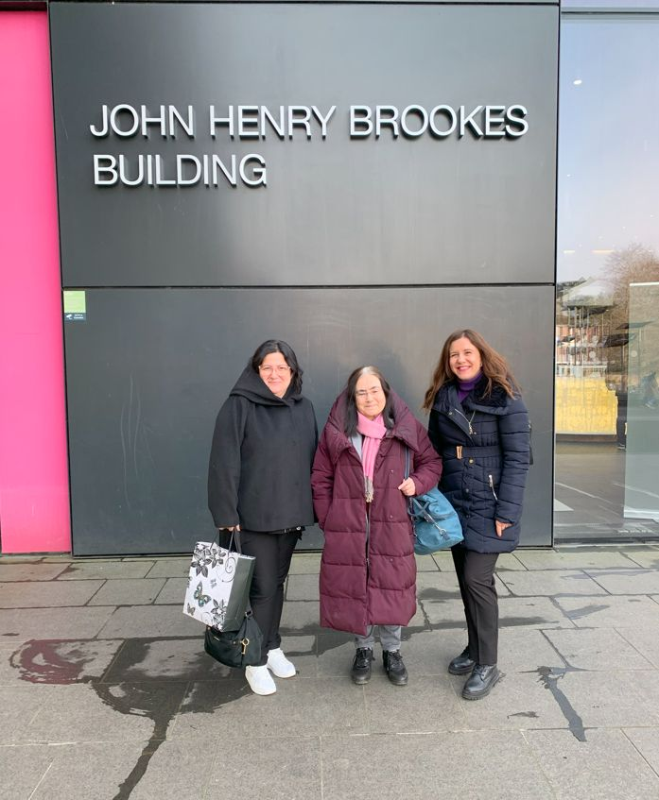
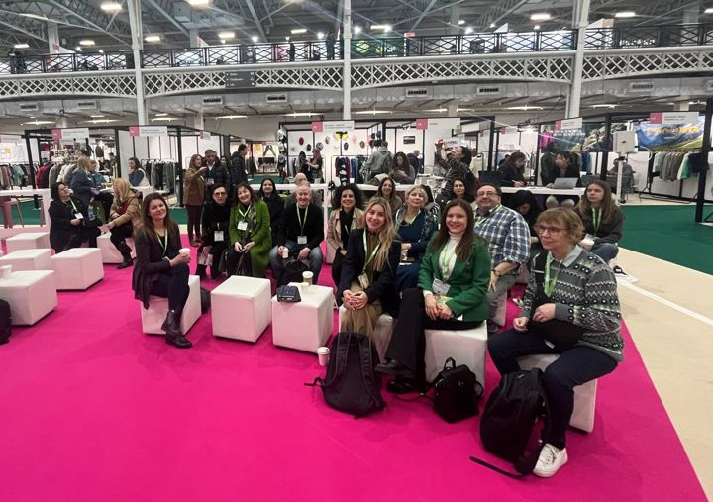
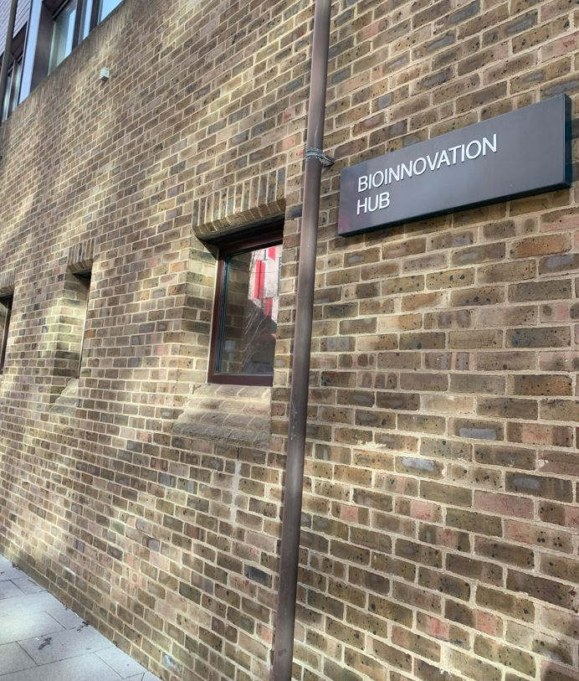
Highlights from North Macedonia
Study visit to Oxford & London
MIR Foundation’s UK Peer-Learning Study Visit: Driving Innovation & Sustainability
John Henry Brookes Building, Oxford
Fashion Source Fair 2025, exploring sustainable textiles, circular fashion, biomaterials, and innovation in textile production—an essential focus of the Macedonian Smart Specialisation Strategy (S3), London
BioInnovation Hub

Slide 17
Activities in Serbia
CONCLUDED
ONGOING
ON HOLD
Capacity Building Activity | Status and results in 2024-2025
Strengthening the capacity of the business sector for digital skills | Concluded before
Green Transformation: New skills required to master the green transition | Concluded before
Green Transition (advanced level) | Concluded. Five workshops were held, engaging 83 participants from diverse sectors.
Training sessions on programme evaluation: evaluation practices in policies and programmes | Ongoing. Five workshops across Serbia engaged 52 representatives from the private, academic and public sectors.
Video about the methodology of the workshop https://www.youtube.com/watch?v=qKrYP4Cy_24
Link to the video with the testimonials of the companies https://www.youtube.com/watch?v=CdVHfTA4tRw
Notes:
17

Slide 18
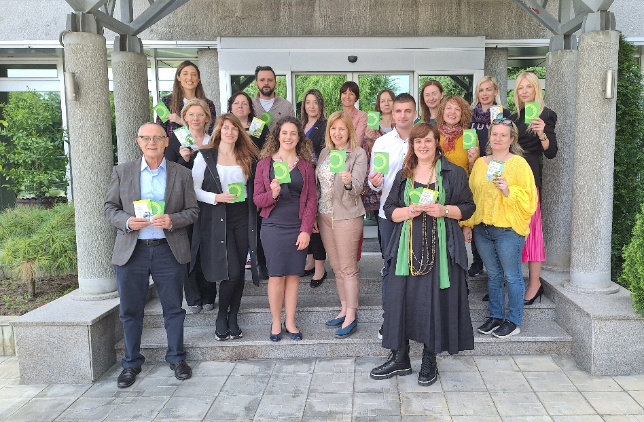
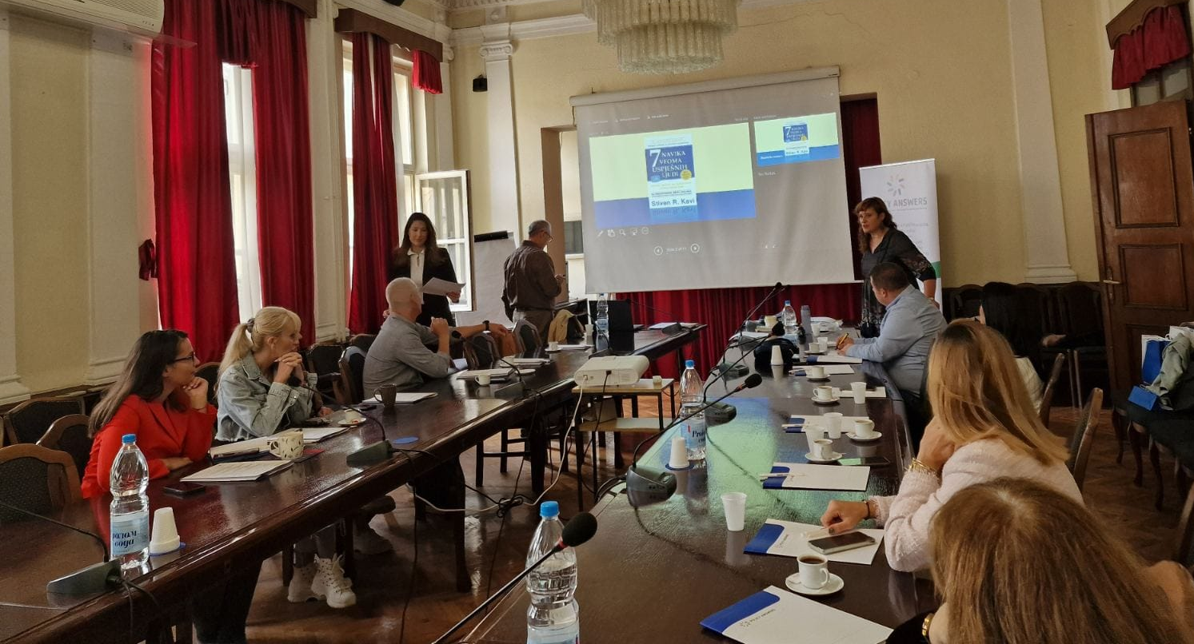
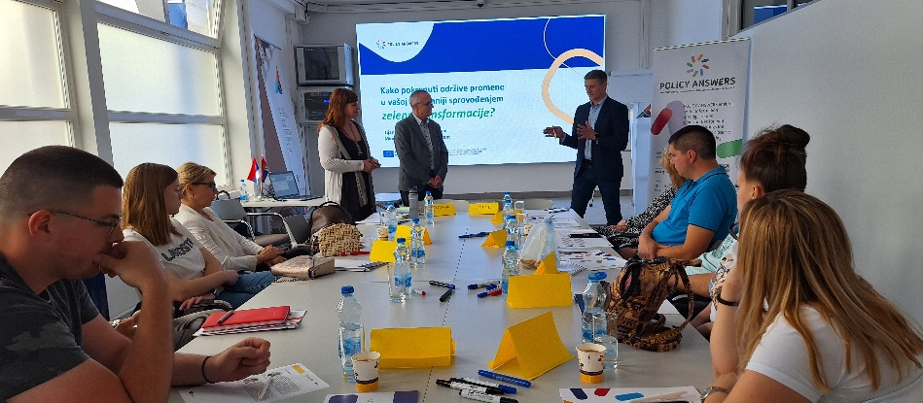
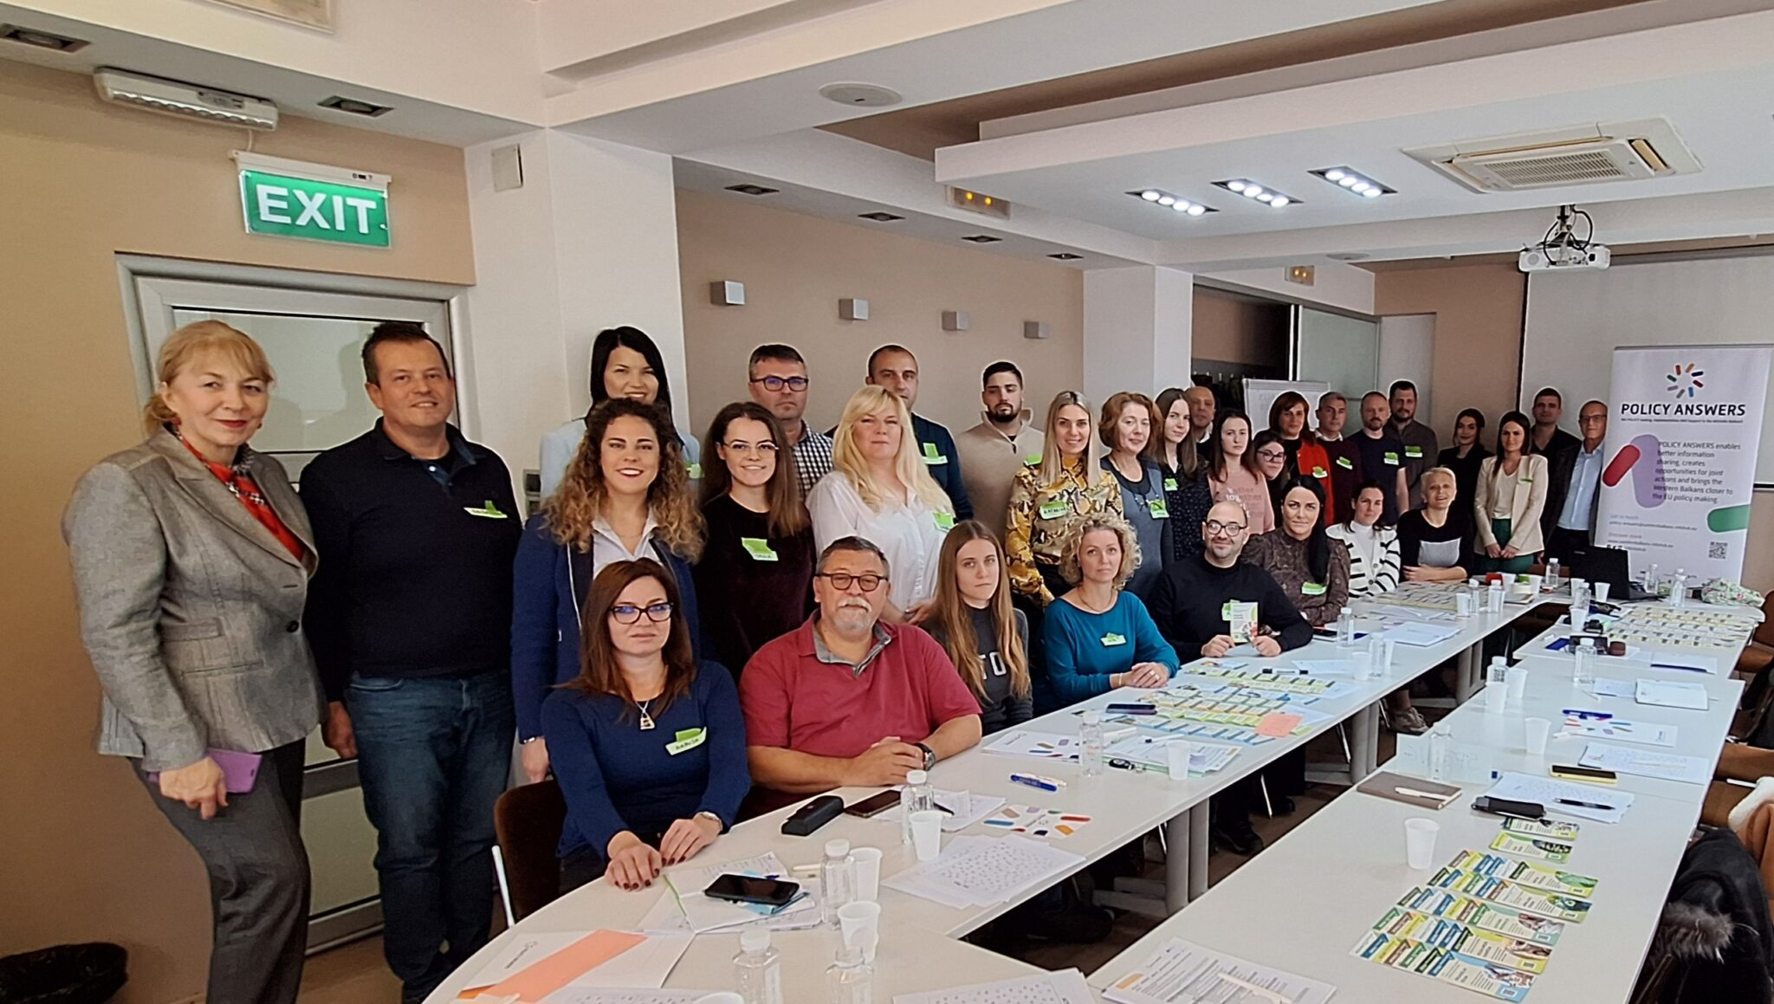
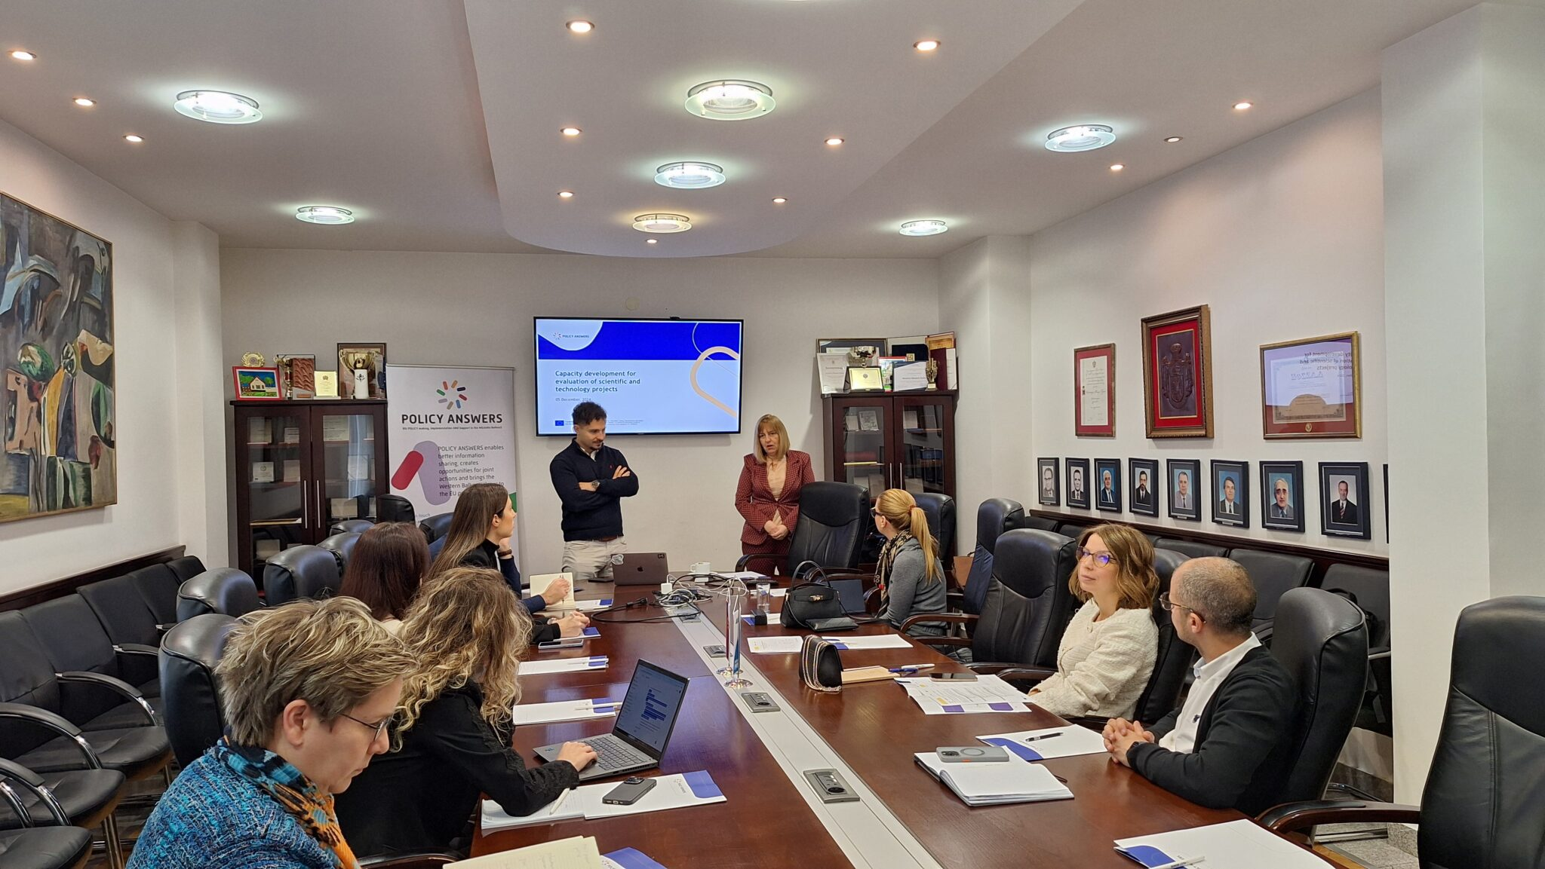
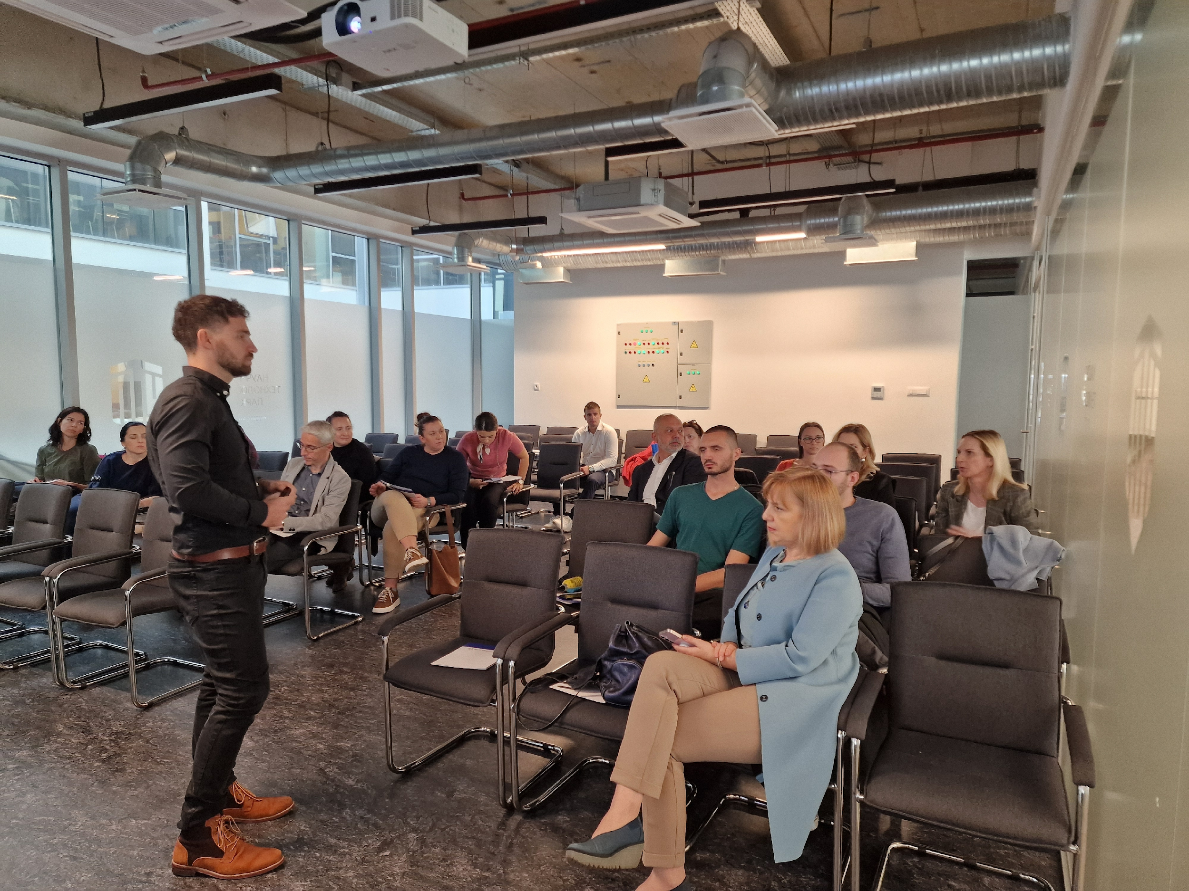
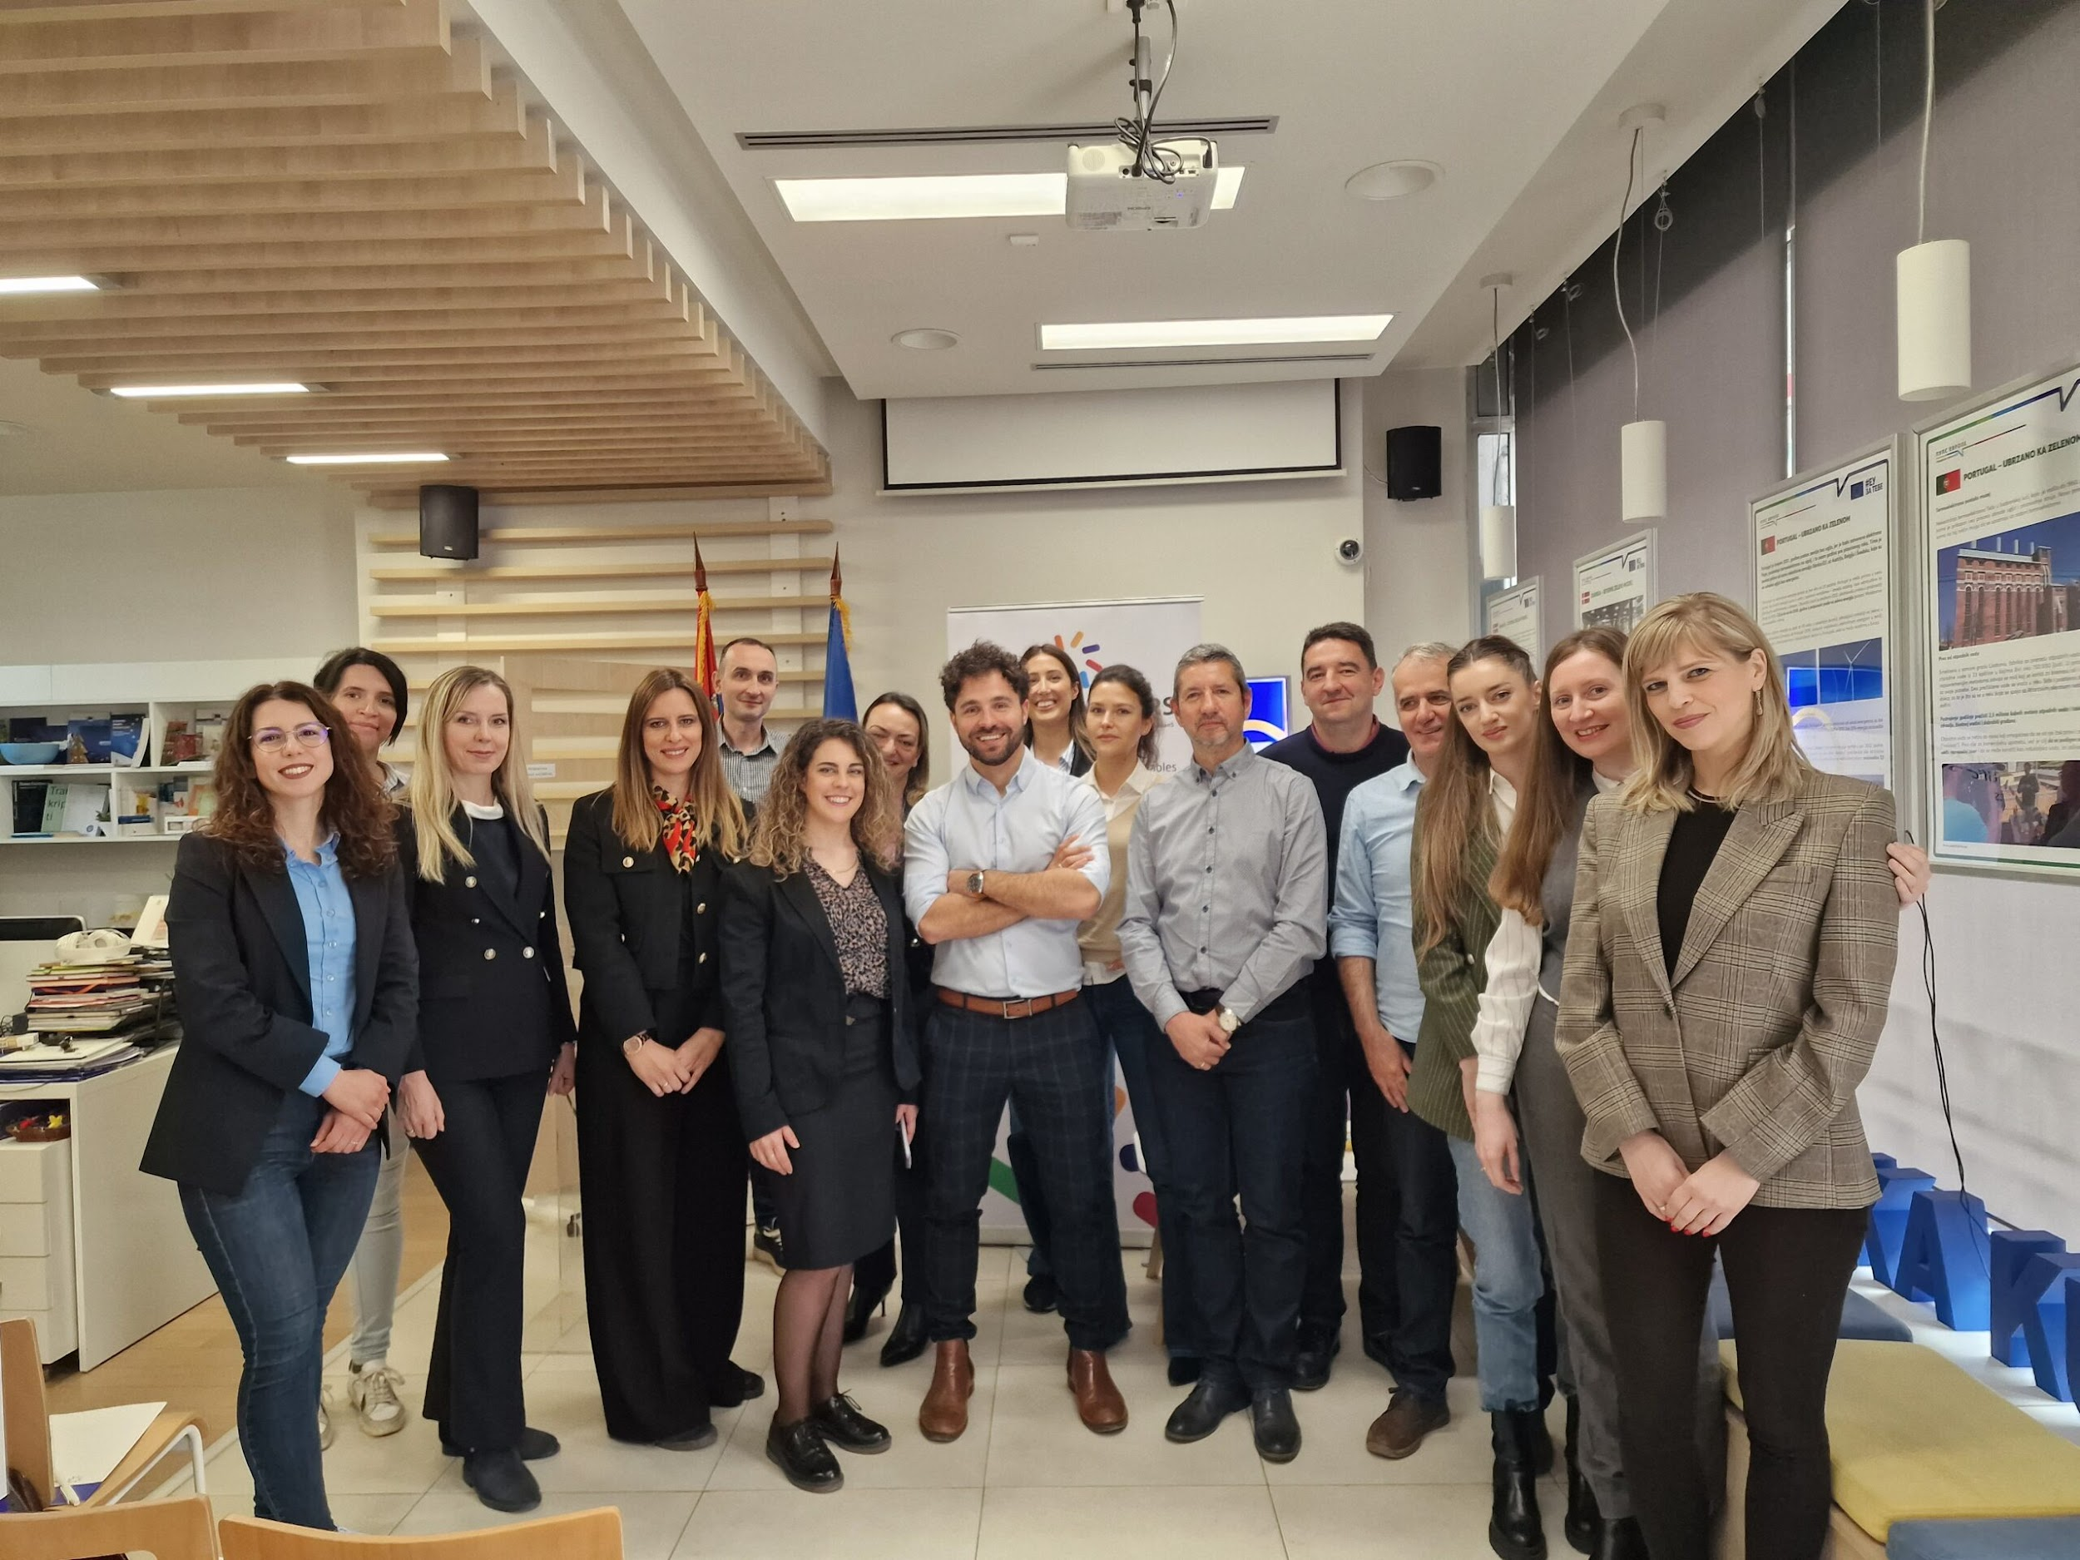
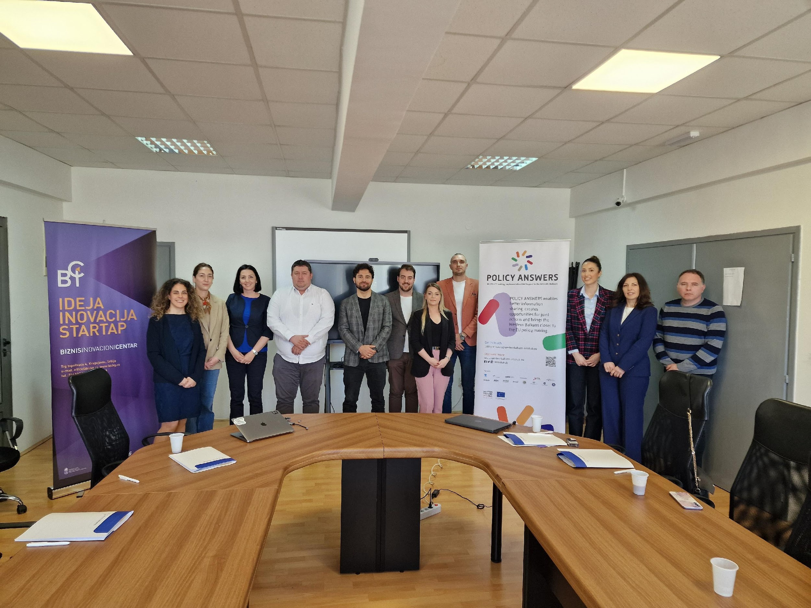
Highlights from Serbia
Green Transition (Belgrade, Nis, Cacak, Krusevac, Valjevo – 2024)
Monitoring & Evaluation (Belgrade & Novi Sad – 2024; Nis & Kragujevac – 2025)

Slide 19

Peer learning
Peer-Learning Webinars
Focused on topics where partners performed best
6 webinars, one per task / WB economy
1 completed (Serbia, Task 3.6), others planned for May, June, July, and September
TOPICS:
Strengthening SMEs for the Twin Transition through Capacity Building Activities (IMP)
Open Science & IPR (UNIVL & UNSA)
Preparing Applications for Horizon Europe Projects (RIINVEST)
Circular/Green Economy (STP-MNE)
GEP Development (NASRI)
Training on Policy Design, Coordination, and M&E (FITD & MIR)

Slide 20
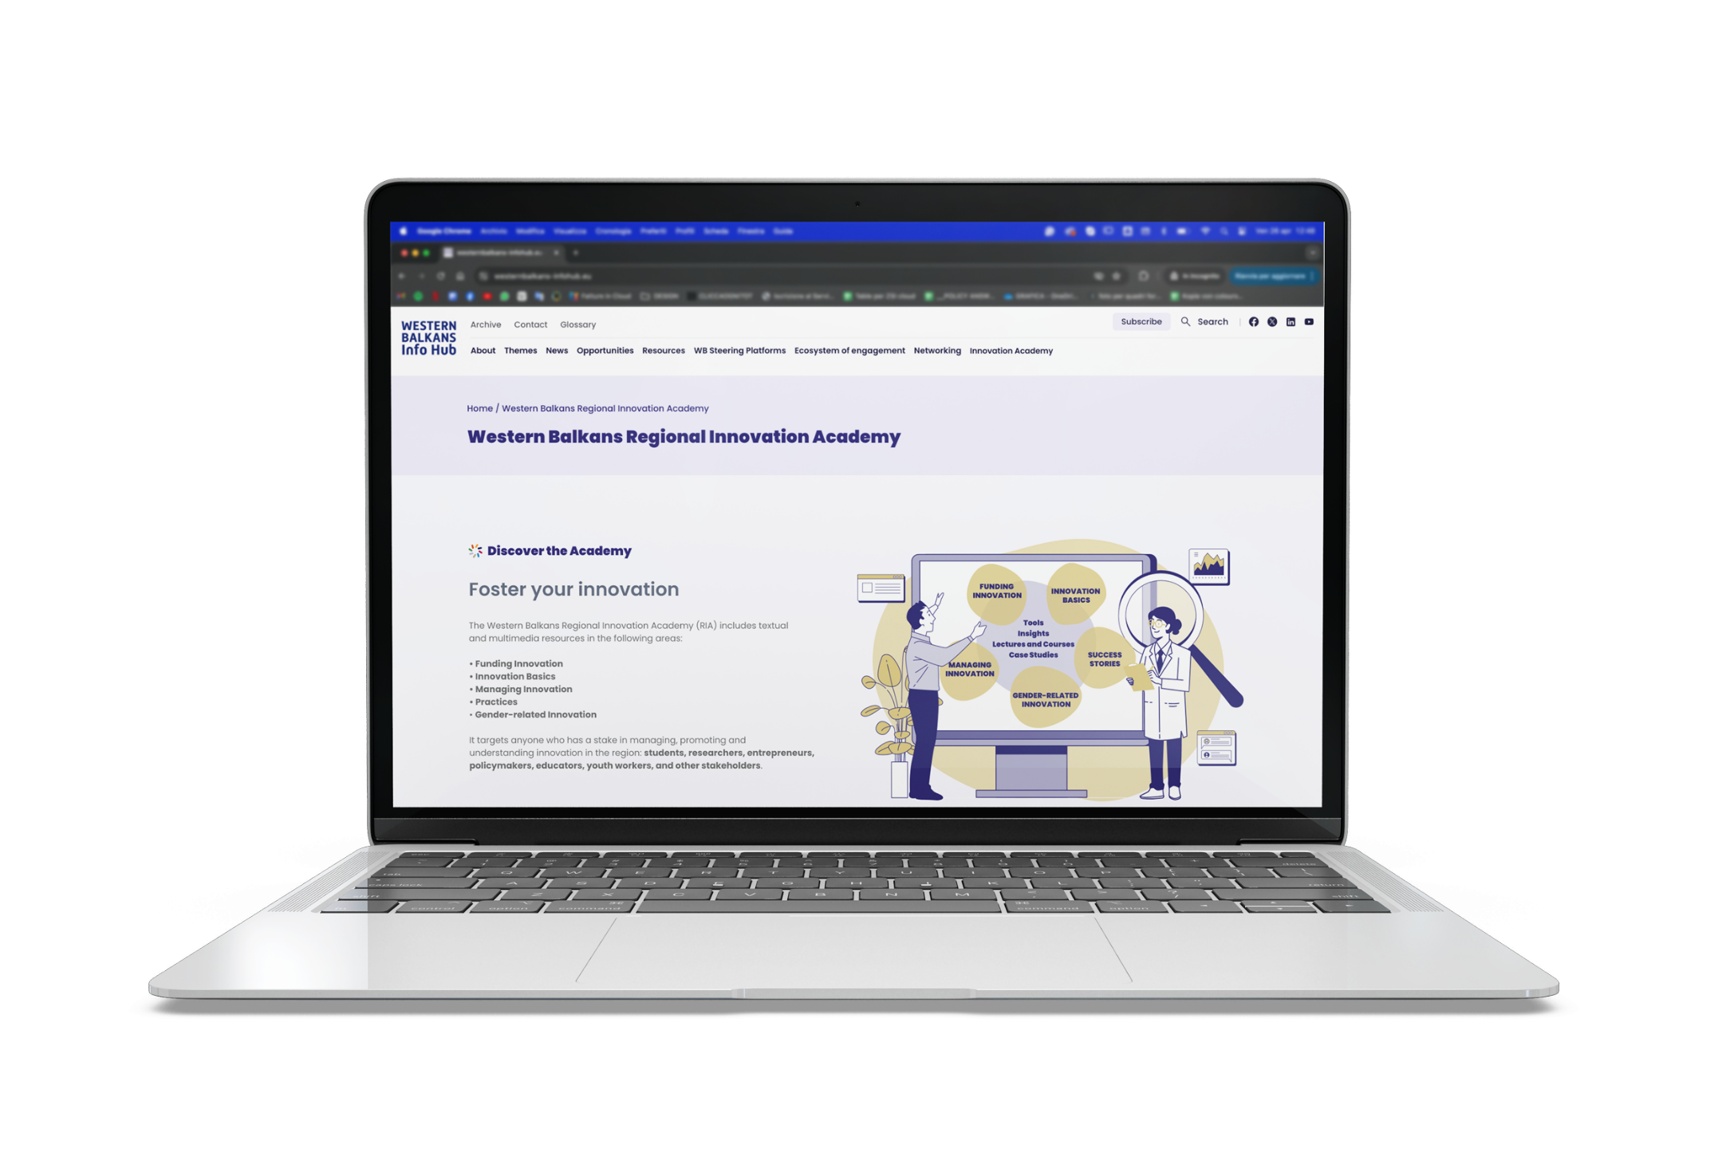
Western Balkan Regional Innovation Academy
https://westernbalkans-infohub.eu/western-balkans-regional-innovation-academy/
24 educational materials collected, grouped in five areas including: Innovation Basics, Managing Innovation, Innovation Funding, Success Stories & Gender related Innovation
Educational materials are grouped in four main categories: Tools, Insights, Lectures/Courses and Case Studies
Notes:
In order to be kept up to date, we recommend to make sure you receive our newsletter and follow us online on the website and social media
20

Slide 21
policy-answers@westernbalkans-infohub.eu
sanjap.pantic@pupin.rs
Notes:
21

