Slide 1


R&I Policy Support for Enlargement Countries
POLICY ENLARGE
Towards a Stronger European Research Area:
Lessons and Pathways for the Western Balkans’ Participation
POLICY ANSWERS final public event
19 March 2026, Tirana
Dr Béla Kardon Chief Scientific Officer
Regional Centre for Information and Scientific Development

Slide 2
The Proposal
Call: HORIZON-WIDERA-2025-04-ACCESS-01
Support for R&I policy making in the EU enlargement countries
Type of action: CSA
Budget: EUR 3M
Published: 14 May 2025 under work programme 11; Widening participation and strengthening the European Research Area
Deadline: 16 September 2025

Slide 3
The Project - Policy Enlarge in a nutshell
Supporting R&I policy making in EU enlargement countries
Successor to the POLICY ANSWERS project (101058873), building on 20 years of WB policy dialogue and the Western Balkans Info Hub
Objective:
strengthen evidence-based R&I policies, implementation and coordination, and support deeper integration into the ERA and future EU programmes
Geographical scope:
Western Balkans plus Georgia, Moldova, Ukraine and Türkiye, using variable-geometry formats to address different needs
Approach: five pillars – policy dialogue; policy guidance & learning; joint actions & financial support to third parties; capacity building; communication & Enlargement Info Hub

Slide 4
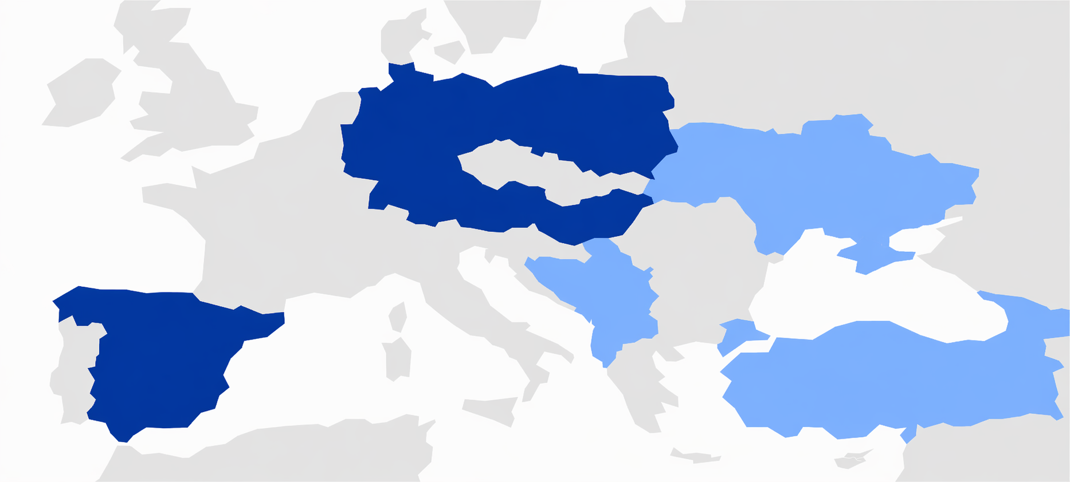
Consortium
Beneficiaries | Associated partners
Regional Centre for Information and Scientific Development (RCISD, HU)
Barleti University (UniBa, AL)
Centre for Social Innovation (ZSI, AT)
The University of Sarajevo (UNSA, BA)
The University of Banja Luka (UNIBL, BA)
Georgian Institute for Research and Innovation (GIRI, GE)
Deutsches Zentrum für Luft- und Raumfahrt (DLR, DE)
RIINVEST Institute (XK)
National Agency for Research and Development (NARD, MD)
Science and Technology Park Montenegro (STP MNE, ME)
Foundation for Management and Industrial Research (MIR, MK)
FundingBox Accelerator sp. z o.o. (FBA, PL) +1 affiliated entity
Institute of Economic Sciences (IEN, RS)
Scientific and Technological Research Council of Turkey (TUBITAK, TR)
State Organization Institute for Economics and Forecasting Ukrainian National Academy of Sciences (IEF, UA)
Moholy-Nagy University of Art and Design in Budapest (MOME, HU)
National Agency for Scientific Research and Innovation (NASRI, AL)
Ministry of Civil Affairs of Bosnia and Herzegovina (MCA B&H, BA)
Ministry of Education, Science and Youth of Georgia (MOESYGE, GE)
Ministry of Education, Science and Innovation of Montenegro (MESI, ME)
Ministry of Science, Technological Development and Innovation (NITRA, RS)

Slide 5
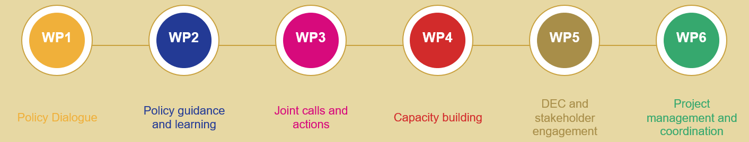
Work Packages
Policy Dialogue (ZSI)
Policy Guidance and Learning (DLR)
Joint calls and actions (Funding Box)
Capacity building (RCISD)
Communication, Dissemination, Exploitation and Stakeholder Engagement (ZSI)
Project Management and Coordination (RCISD)

Slide 6
Work Package 1 - Policy Dialogue
Task 1.1 High-level dialogue in variable geometry (ZSI; M1-M36)
Task 1.2 Policy dialogue workshops (ZSI; M1-M36)
Task 1.3 Online dialogue events (ZSI; M1-M36)

Slide 7
Work Package 2 - Policy Guidance and Learning
Task 2.1 ERA Integration and Widening (DLR; M1-M36)
Task 2.2 Research Infrastructures (TUBITAK; M1-M36)
Task 2.3 Science-business cooperation/Business R&D (STP MNE; M1-M36)
Task 2.4 Knowledge valorisation (IEN; M1-M36)

Slide 8
Work Package 3
Joint calls and actions (EUR 300 000 FSTP; 80% funding rate)
Fixed lump sum per Funding Instruments
Funding Instruments | Third Party Project duration | Nº third parties per Third Party Project | Amount per third party | Lump sum per Third Party Project
Small Grants for Joint Regional Innovation Actions | up to 6 months | 2 third parties | Up to 4 000 € per third party [1] | Up to 8 000 € per third party project [2]
Small Grants for collaborative uptake of results | up to 6 months | 2 third parties | Up to 4 000 € per third party | Up to 8 000 € per third party project
Small grants for People-to-People Cooperation Projects | up to 6 months | 2 third parties or secondees | From 2 500 € to 5 000€ per secondee | Up to 5 000 € per mobility grant

Slide 9
Work Package 4 - Capacity building
Targeted R&I capacity building in all 10 enlargement economies, based on needs identified with national partners
Focus on Horizon Europe participation, S3, technology transfer, research management, Green Deal and digital transition
50 000 EUR per country for tailored national actions (workshops, trainings, study visits, mentoring, expert missions)
Strengthens skills of researchers, HEIs & research institutions, SMEs and start-ups
Shares good practices and success stories across the region, supported by common methodology and monitoring from RCISD

Slide 10
Thank you for your attention!
Dr Béla Kardon CSO
Regional Centre for Information and Scientific Development
bkardon@rcisd.eu
info@rcisd.eu
www.rcisd.eu

